Slide 1
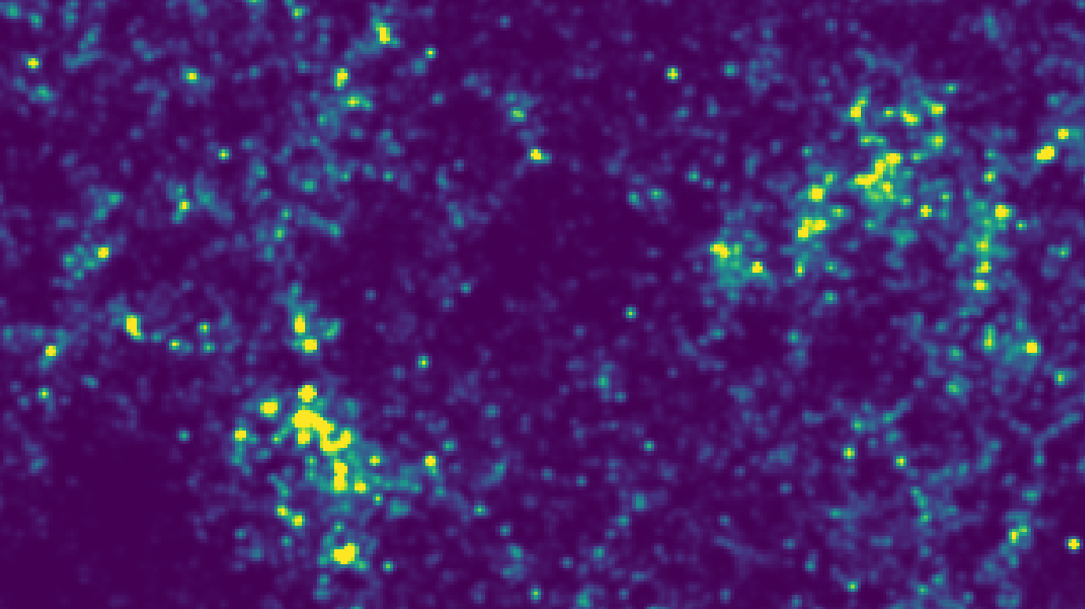
[C II] Line Intensity Mapping
A Novel Method to Probe the Universe
Patrick Horlaville
PHY 600: Seminar I
Bishop’s University
November 3rd, 2023
1

Slide 2
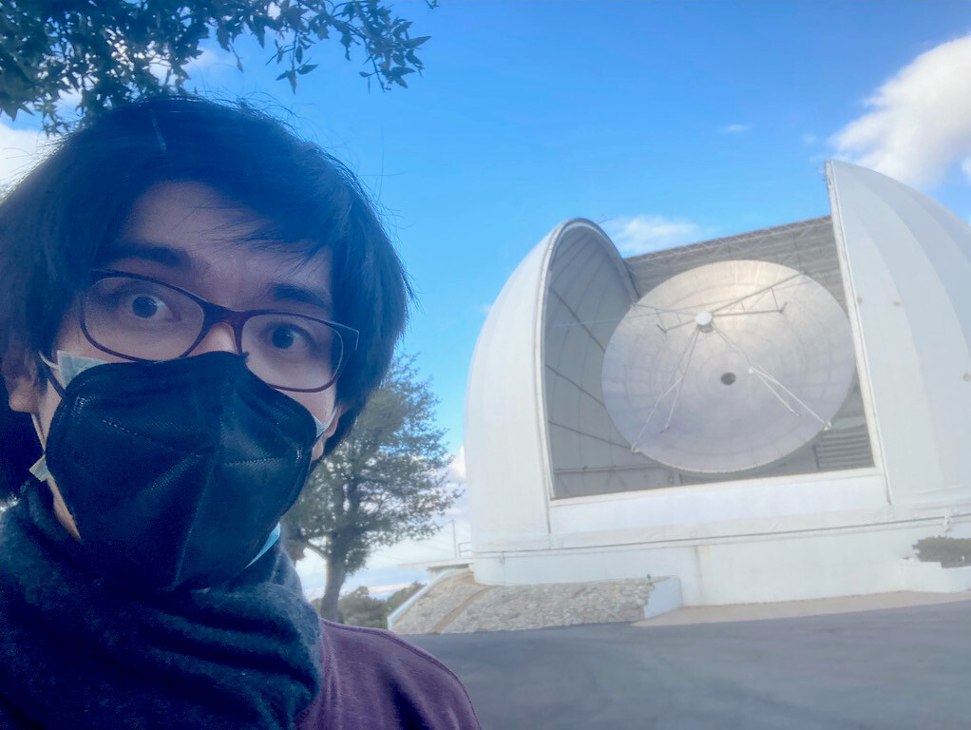

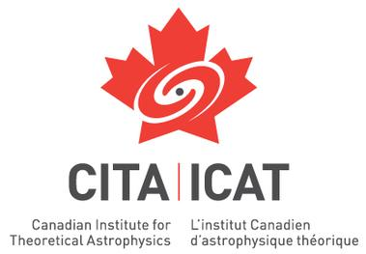





Collaborators
Dr Dongwoo Chung (CITA, Dunlap)
Prof. Dick Bond (CITA)
Dr Lichen Liang (CITA)
Nathan Carlson (CITA, UofT)
Doğa Tolgay (CITA, UofT)
Dr Patrick Breysse (NYU)
Dr Zack Li (UC Berkley)
2

Slide 3
Outline
History of the Universe
What is Line Intensity Mapping?
The Origins of the [C II] Line
FIRE Simulations
Where Do Galaxies Live?
Connecting [C II] to Halos
Simulation Results
Perspectives
3

Slide 4
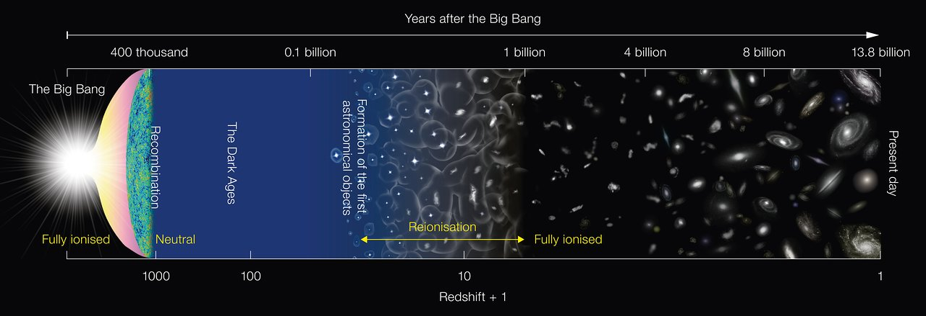
History of the Universe
EoR
Figure: NAOJ/ESO
4
Notes:
Over the last decades, the paradigm of research in cosmology has been focused towards studying the CMB and galaxy surveys at lower redshift, which has considerably propelled forward our current understanding of the evolution of the universe. Nowadays, many endeavors have developed outside of those areas, notably around the time of galaxy formation, towards the epoch of reionization (around redshift 10). At the junction of cosmology and extragalactic astrophysics, between structure formation and galaxy formation, the EoR is a fundamental part of the cosmology puzzle located right between today and the CMB.
However, while traditional galaxy surveys have been able to gain significant insight on the properties of galaxies not too far from our own, they struggle to detect enough galaxies around the EoR to be able to draw a large-scale cosmological probe. On the other hand, techniques used to observe the cosmic microwave background radiation are no good to study the EoR: while the CMB is a relic of thermal radiation from the early Universe that behaves as a nice random Gaussian random field, the EoR emission is much more complex and embeds information on the formation of some of the first galaxies as well as large-scale structures.
Therefore, how can we probe the information content of galaxies of the EoR to a degree that is sufficient to trace back cosmic history?

Slide 5
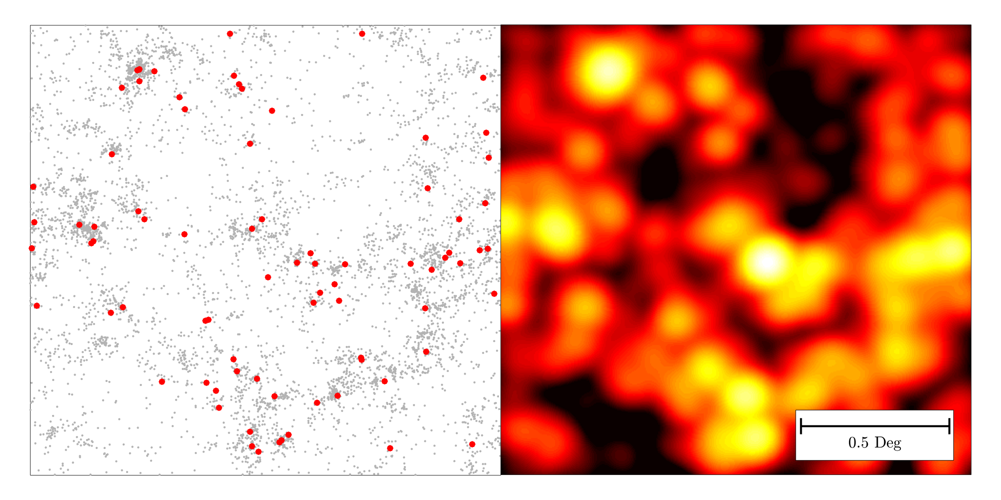
Line Intensity Mapping
[C II]:
Galaxy survey:
CO LIM:
CO:
H I:
Kovetz et al., 2017
(Figure by Patrick Breysse)
Horlaville et al., 2023
5
LIM can trace cosmic structure!
Notes:
It’s in that prospect that a new observational technique was created. Line intensity mapping (or LIM), rather than trying to achieve maximum angular resolution to detect individual galaxies, looks at the integrated emission of any one spectral line (such as carbon-monoxide, neutral hydrogen, Lyman-alpha, H-alpha, and more), hence capturing all the photons within one line of sight, gathering information about unresolved galaxies and the IGM. LIM therefore lies at the interface of astrophysics and cosmology, between small-scale and large-scale astronomy.
(Point to left picture)
For illustration, the left panel shows the galaxies that would be in the scope of detection, in red, of a 2.5deg^2 patch of the sky at redshift 3 of a radio observing campaign comprised of dozens of dishes and observing for thousands of hours. The underlying galaxy population is shown in grey. Even in this perfect (and very unrealistic) scenario, just about 1% of galaxies would be detected. On the other hand, a line intensity mapping experiment, by gathering all the light emitted by a specific spectral line (here, carbon monoxide CO), would be able to detect the fluctuations of the signal across the map.
(*LIM map has no noise injected, and the model for the detection is not up to date, it’s just for illustration*)
Other lines can be targeted by LIM.
(Point to right picture) This figure shows the simulation of various line signals emanating from the same lightcone of halos. Top is singly ionized carbon, or [C II], middle is CO, and bottom is neutral hydrogen, or HI. The right panel of each row shows the angular slice of the simulation, perpendicular to our line of sight, while the left panel shows a slice parallel to our line of sight, showing evolution with redshift. Since each line is observed in different ranges of frequency, the experiments that will observe them will have different beam widths, which here is reflected in each line’s map angular resolution.
(*upcoming detection of [C II] should be performed with a beam width of about 20”, 4’ for CO and 10’ for HI.*)
The goal of my project is to simulate the signal of [C II] around the end of the EoR, around redshift 6 to 8. But what is the [C II] line?

Slide 6



The Origins of the [C II] Line
ionized intergalactic medium
self-shielding neutral gas
[C II]
H I
cold molecular gas
H₂
C I
CO
Need to meticulously probe the galactic scale…
star formation
[C II]
H II
N II
H II
6
schematic adapted from: E. Switzer
Notes:
[C II] is the fine structure line of ionized carbon. It is the brightest line emitted from molecular clouds’ outer layer undergoing photo-dissociation. Typically, when most UV and optical stellar radiation is being absorbed by dust and being re-emitted in the infrared, then the gas heating rate is proportional to [C II] luminosity and atomic gas fraction, which is why this line has been suggested as a tracer for molecular gas and star formation history. Therefore, tracing [C II] through LIM appears to be a natural path to gain further insight on the cosmic star formation history of higher redshift galaxies. However, the relationship between the [C II] line with star formation rate does not seem to be as straightforward, with a growing body of evidence suggesting that the [C II] signal is modulated by other factors at higher redshift, such as metallicity.
With line intensity mapping experiments coming online now and soon that will notably probe [C II], it is therefore needed to match the experimental progress that will be brought forward by observations with a more sophisticated theoretical understanding of the modelling of [C II].
And a great avenue to gain insight on the physical processes underlying the emission of lines such as [C II] is to look into cosmological simulations.

Slide 7
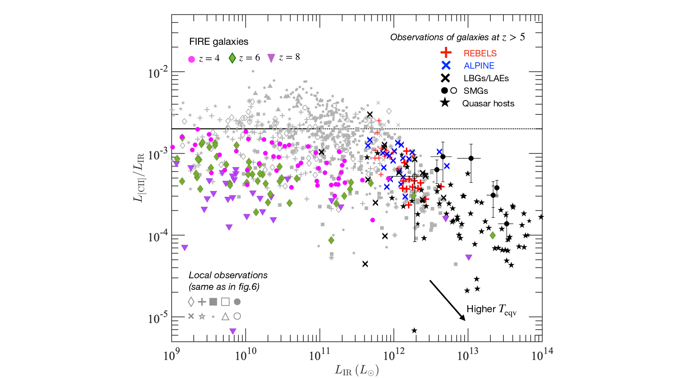
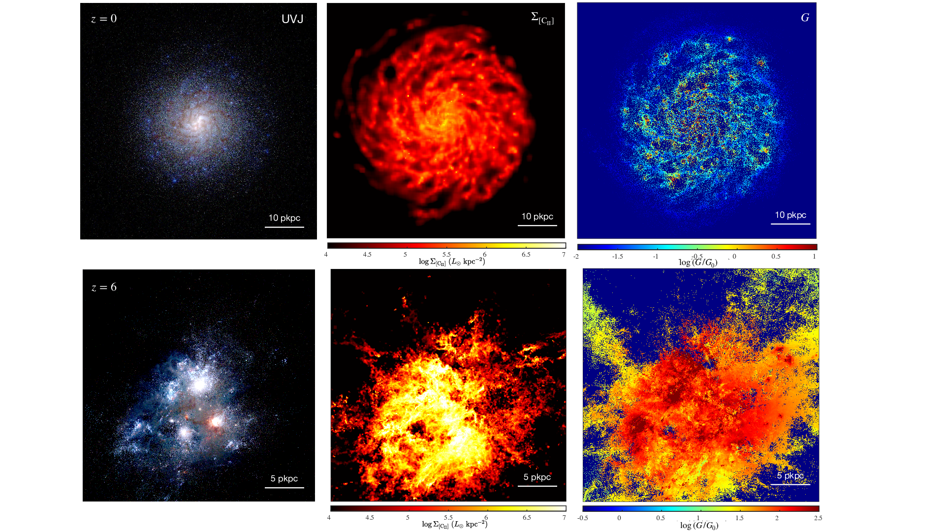




FIRE Simulations
[C II]/IR luminosity relationship
Snapshots of FIRE galaxies
Liang et al., 2023
High-resolution galaxy simulations
$$⇒$$
$$⇒$$
$$L_{\left[CII\right]}∝M_{HI}{\overline{Z}}_{gas}$$
$$L_{[CII]}∝f_{\left[CII\right]}M_{gas}{\overline{Z}}_{gas}$$
7
Larger-scale cosmology
Notes:
Notably, the Feedback In Realistic Environments (FIRE) cosmological simulations, using prescriptions for hydrodynamics and feedback, provide insightful information on star-forming galaxies from redshift 0 to 8. With the help of post-processing, many galaxy properties can be inferred from those simulations, such as their [C II] luminosity, SFR or infrared luminosity.
(Point to left picture)
This figure shows a few snapshots of 2 FIRE galaxies, at redshift 0 and 6. Here, the left panels show UVJ false-colour imaging, and the right panels show the [C II] surface brightness.
By deriving all this information, we can investigate the relationship between a plethora of physical parameters.
(Point to right picture)
For example, this plot shows the relationship between galaxies’ [C II] and infrared luminosity drawn from FIRE (in color), with observational data plotted alongside (in grey).
Among all the information extracted from those simulations, one of the key results is that the [C II] luminosity of galaxies appears to be modulated by those parameters
(Point to equation)
where f_CII is the fraction of total galactic mass coming from HI and HII regions, Z_gas is the average gas metallicity and M_gas is the total gas mass of the galaxy.
By the definition of f_CII, f_CII * M_gas = gas mass from HI and HII regions; however, simulations show that HI regions are the dominating the contribution of the CII signal over HII, therefore we can simplify f_CII * M_gas by the total HI mass from the galaxy, M_HI.
We can now use this scaling relationship on greater ensembles of simulated galaxies to model the larger-scale emission of [C II].
In summary, the complex cosmological simulations modelling galaxies, their structure and their properties allow to establish simple scaling relationships that can be used, in my case, to model galactic [C II] emission using a few parameters. That way, we can now zoom out of the galactic scale and model the [C II] emission as an average over larger scales. But what do I mean by larger scales? If I’m zooming out of galaxies, am I still looking at galaxies? No!
archive:
(Point to equation)
where f_CII is the fraction of total galactic mass coming from HI and HII regions, Z_gas is the average gas metallicity, t_dep is the depletion time scale and is just equal to the total gas mass divided by the SFR, and n_gas is the average gas density
f_CII * M_gas = gas mass from HI and HII regions; and simulations show that HI regions are the dominating the contribution of the CII signal over HII

Slide 8

Where Do Galaxies Live?
spiral disk
halo
8
… in dark matter halos!
Notes:
Rather, I am looking into the environment englobing galaxies. While we have no direct observations of those structures, it is theorized that galaxies live in greater ensemble structures gravitationally bound by dark matter that are called halos, at the center of which reside the galaxies. For my simulations, I am modelling the signal not coming from galaxies, but rather from those dark matter halos. However, because the emission of halos is driven by their galaxies, we can use galactic scaling relationships for halos.

Slide 9

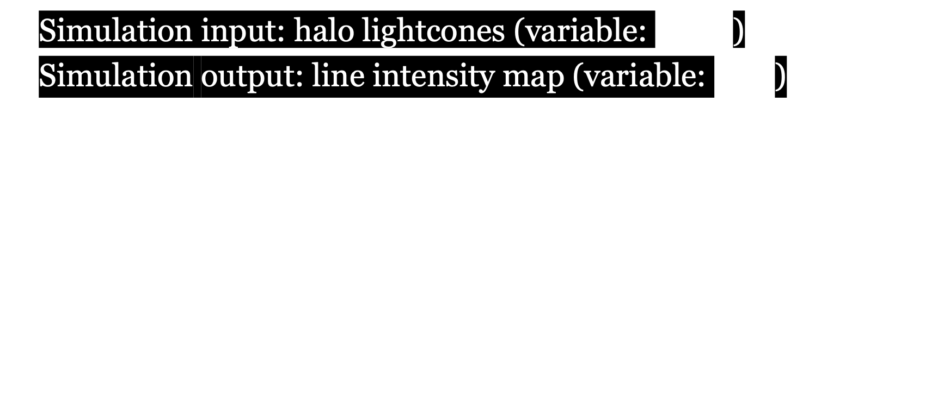


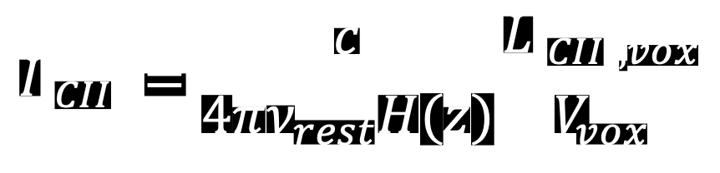
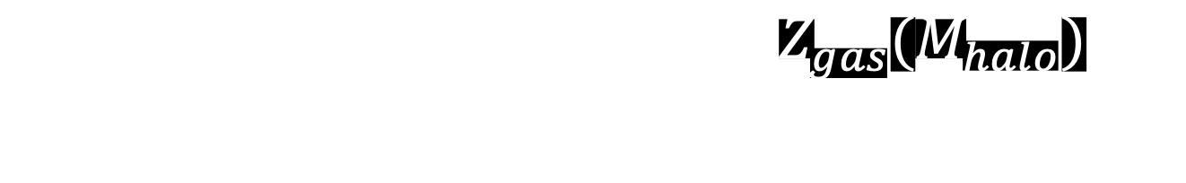

Connecting [C II] to Halos
Simulation input: halo lightcones (variable: $M_{halo}$)
Simulation output: line intensity map (variable: $I_{[CII]}$)
$$α_{[CII]}$$
$$σ_{Z}$$
$$\frac{L_{\left[CII\right]}}{L_{⊙}}=0.024 \frac{M_{HI}(M_{halo})}{M_{⊙}}\frac{Z_{gas}(M_{halo})}{Z_{⊙}}$$
$$I_{\left[CII\right]}=\frac{c}{4πν_{rest}H(z)}\frac{L_{\left[CII\right],vox}}{V_{vox}}$$
$$⇒$$
$$(+Beaming \& White Noise)$$
We can make intensity maps!
9
Notes:
To simulate the [C II] signal on those larger scales, I used a suite of simulated halo lightcones, which is a volume containing thousands of halos. The lightcone encloses information only on the position and mass of the halos, and our formula here is the bridge to retrieve the halo’s [C II] luminosity from its mass
(Point to luminosity equation) This is the final version of the equation I am using to model the [C II] luminosity of halos as a function of their mass. The HI mass and the metallicity are determined using different sets of prescriptions. Notably, we inject scattering in our metallicity through the sigma_Z parameter, which corresponds to the magnitude of the scatter. Note that because the metallicity is directly proportional to the [C II] luminosity, this scatter in metallicity is in effect a scatter in [C II] luminosity. This is a rudimentary implementation of the complex baryonic physics occurring inside each halo driving the emission of [C II], which we model as a simple stochastic process.
However, that only allows to find halos’ [C II] luminosities, which is the intrinsic signal from each halo. The observed signal is an intensity, which depends on our distance to the halos. Also, as we do not resolve for each individual halos, our simulation bins the 3D space (redshift + angular dimensions) into voxels. (Point to intensity formula) This formula allows to retrieve the observed [C II] signal, on top of which we can add beaming effect and white noise to make more realistic forecast of upcoming LIM experiments.

Slide 10
Cross-Checking with FIRE Galaxies
FIRE Galaxies
Our Model
Similar shape!
10
Notes:
Before I show the resulting [C II] intensity maps, we can check that the [C II] to infrared luminosity ratio derived from intensity map follows that of FIRE galaxies. On the left, here’s the plot I showed earlier of the [C II] and IR luminosities ratio from the FIRE simulations. On the right, the dashed lines represent the results from my model superposed to the FIRE data, with the stars. Because my simulations englobe thousands of halos, I do not plot individual values. Rather, they are all binned along the x-axis, and the rectangles around the dashed lines represent the 68% and 95% distribution intervals.
The bottom line here is that our simulation results agree with FIRE galaxies; nothing abnormal to report here. that’s good!

Slide 11




[C II] Intensity Map
1
2
Dec
RA
z or $ν$
2
1
11
Tracing cosmic structure!
Notes:
Here I am showing the [C II] intensity maps. The volume of the intensity map, as I already mentioned, is distributed along both angular dimensions and redshift. The signal that is perpendicular to our line of sight is in RA/dec, and is shown with side #1. Parallel to our line of sight is side #2. We cannot observe this slice, but here I am showing it to illustrate the results of our simulations as a function of redshift. One of the noticeable patterns is that as redshift decreases (i.e., as time advances), the [C II] power increases: there is more and more [C II] with time, which makes perfect sense, since at time goes on, stellar nucleosynthesis and dispersion processes increase the abundance of carbon in our Universe.
Overall, we notice that our simulated signal, as much as it doesn’t represent what would directly be observable, can trace our dear large scale cosmic structures!

Slide 12
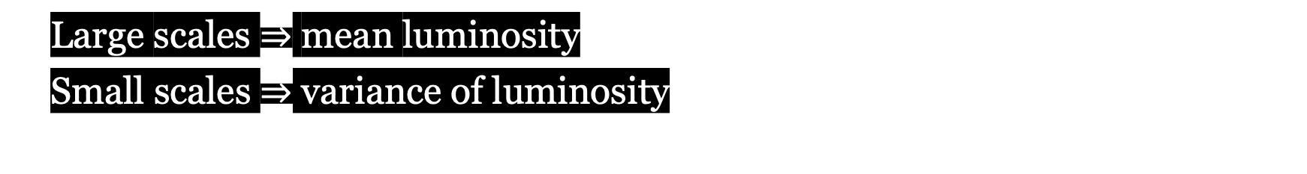
Power Spectrum
Large scales $⇒$ mean luminosity
Small scales $⇒$ variance of luminosity
Signal detection! But…
12
Notes:
Another byproduct of our simulations is the power spectrum of the [C II] signal. The power spectrum tells you what is the power of [C II] across different spatial scales, i.e., on how much signal is present at different scales. At large scales (towards the left of the x-axis), the power is driven by the mean luminosity. On smaller scales (towards the right of the x-axis), the power is driven by the variance of luminosity (i.e., by the scarce bright emitters). The left panel shows the power spectrum at lower redshift and the right panel at higher redshift. Our model’s results are shown by the purple solid line. Notice how much the overall power decreases from lower to higher redshift: that is because as we go to higher redshift, the sources are fainter and the overall signal dims. Other models for [C II] are shown by other solid lines. The dashed lines represent the expected sensitivities to upcoming experiments: if a model line (which represents the power of the signal) lies above a sensitivity line, then we would expect the signal to be detectable, given that particular model and experimental expectation.
For example, if we consider two observational scenarios, CCAT DSS (in red) and Stage 2 LIM (in faded pink), which are shorter term and longer term expected sensitivities respectively, notice that the Stage 2 is much lower than the CCAT DSS scenario: that is because the Stage 2 scenario has many more hours of observation compared to CCAT DSS, so it will be easier for it to detect power. For example, at redshift 6, the [C II] signal is much above the Stage 2 line, meaning that [C II] should be detected with high confidence. However, at higher redshift, the small-scale power of the [C II] signal falls below the Stage 2 sensitivity, meaning that at higher redshift, the Stage 2 would be able to trace the large-scale structures of [C II], but would not be able to find the smallest scale signal, which would be drowned by the noise.
Overall, we predict that in the near-future, LIM experiments will be able to trace the large-scale [C II] signal at higher redshift.
However, using the power spectrum to extract information about our simulations has its limitations.
the power on larger scales is driven by the average [C II] luminosity whereas the power on smaller is driven by the variance of [C II] luminosity
our simulation of the signal is indicated in purple; other [C II] models' predictions are the other solid lines. The dashed lines indicate the expected instrumental sensitivities of upcoming line intensity experiments
quote figures and mention how our model would predict a rare detection of bright [C II] emitters

Slide 13
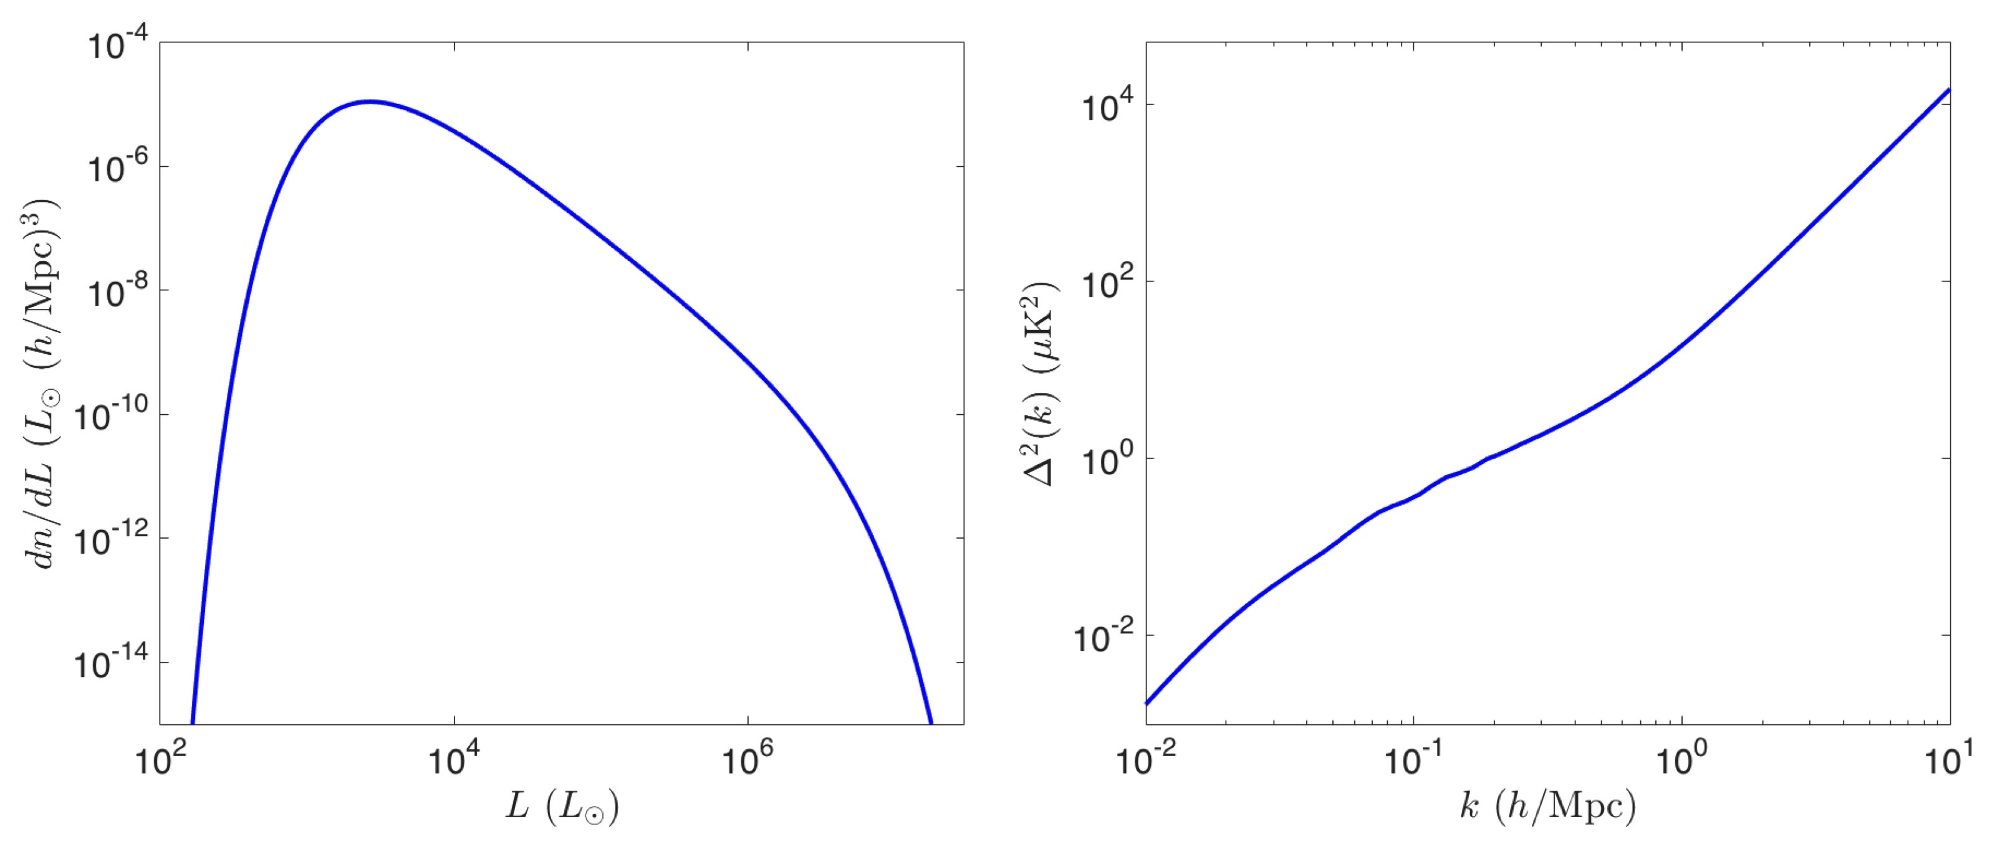
Limitations of the Power Spectrum
Figure: courtesy of Patrick Breysse
Traces the information content of the signal for Gaussian distribution…
13
Notes:
Indeed, the power spectrum is a great statistical tool to probe the information content of Gaussian random fields, which is why it’s ferociously adequate and efficient to probe the CMB radiation for example.
However, the galactic and extra-galactic signal emanating from the Universe around the epoch of reionization is more complex and embeds astrophysical non-gaussianities.
For example, on the left here is shown a luminosity function, which just tells you, for some signal distribution, how many halos have a particular luminosity. Here for example, there are the most halos with a luminosity of about 10^4 L_sol. On the right here is the power spectrum of that signal’s distribution.

Slide 14
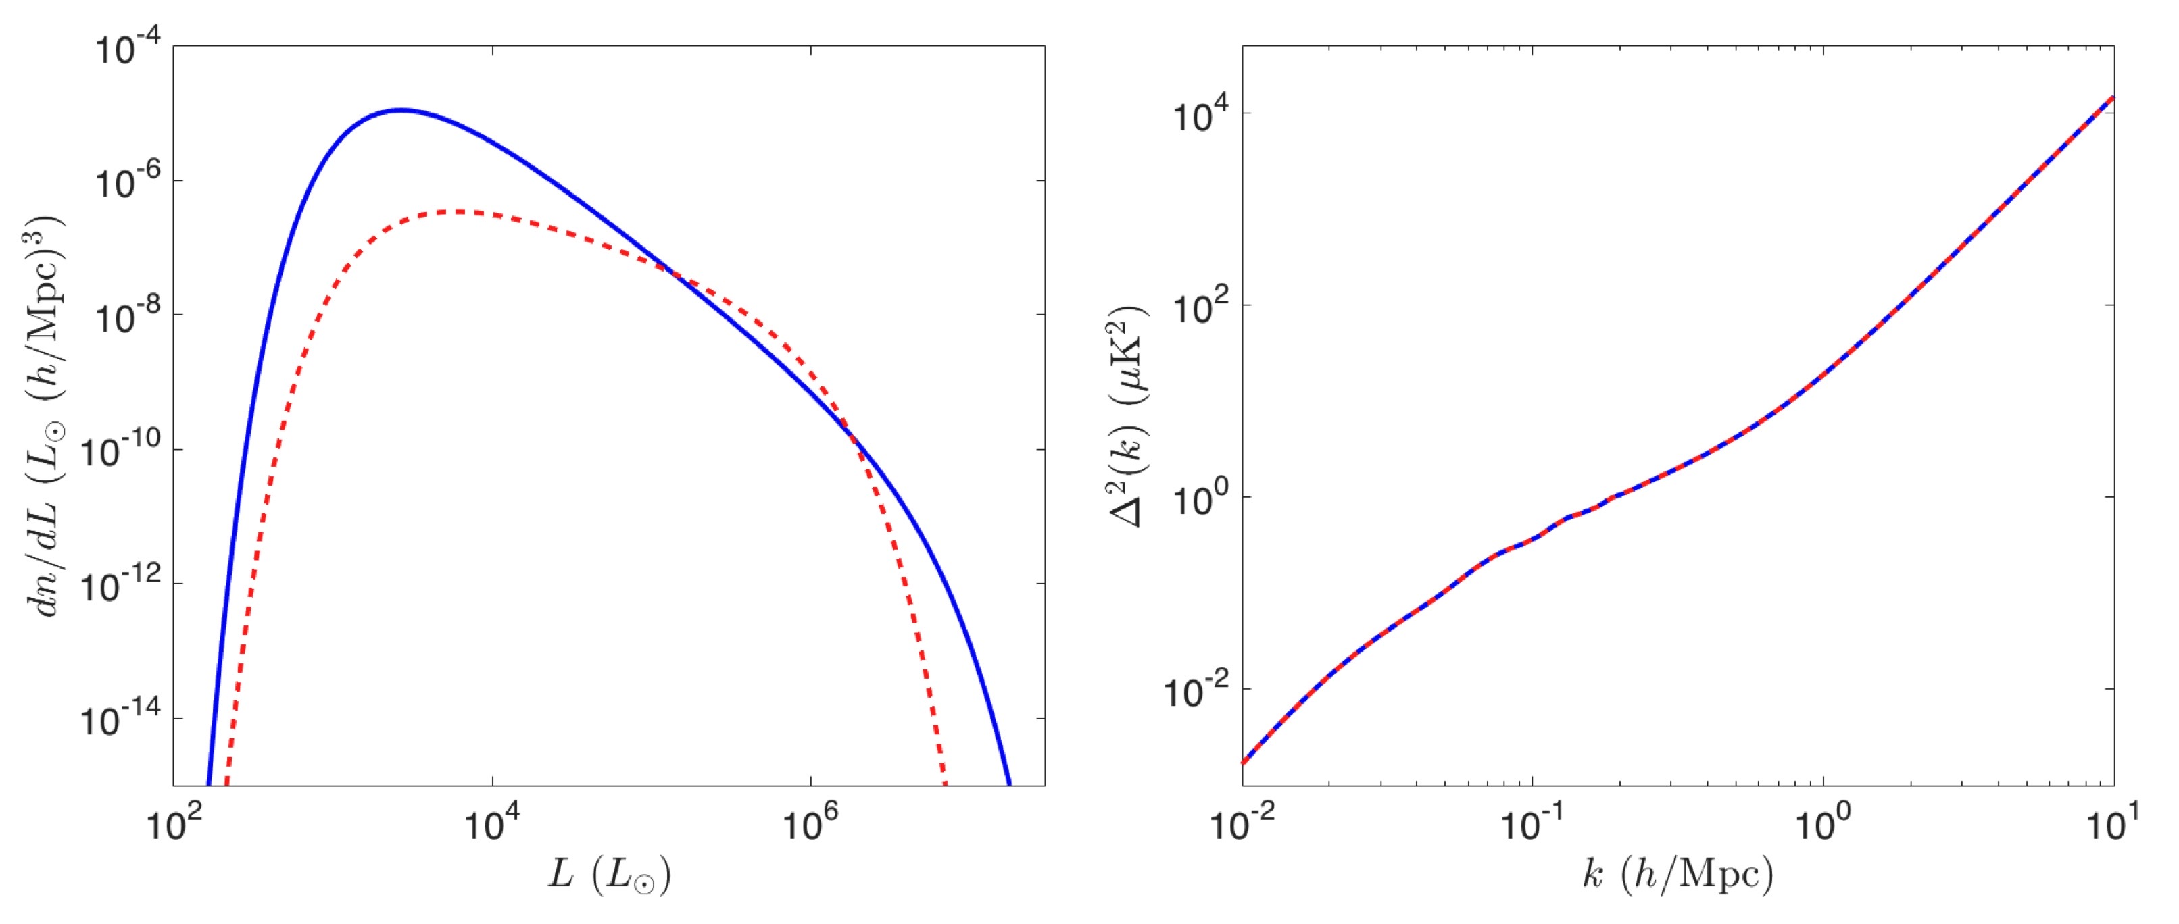
Limitations of the Power Spectrum
Figure: courtesy of Patrick Breysse
… degeneracy possible for Non-Gaussian distributions
14
Notes:
Here, we take another luminosity function, that is, a different distribution of the signal. However, notice that the power spectrum for both luminosity functions is the same! That means that the power spectrum cannot tell the difference between those two distributions, despite them being different. That is because the power spectrum traces the gaussian part of a signal’s distribution and is ‘blind’ to its non-gaussian contributions.
Therefore, what tools could we use to characterize our signal more rigorously if we expect it to be non-gaussian, which is the case for line intensity mapping towards the EoR?

Slide 15
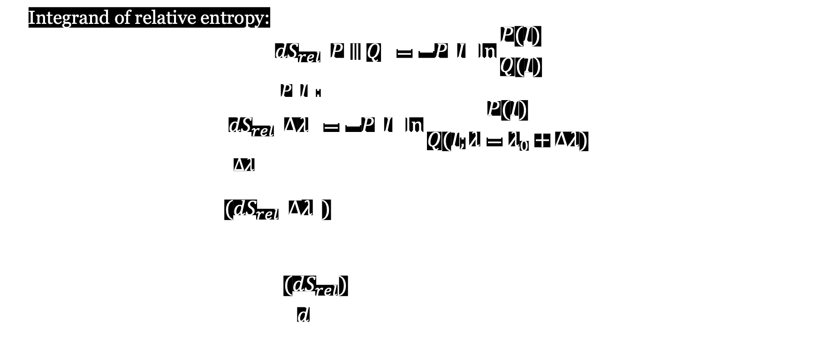

One-Point Statistics’ Formalism
Integrand of relative entropy:
$${dS}_{rel}\left(P∥Q\right)=−P\left(I\right)\ln{\frac{P(I)}{Q(I)}}$$
Take a deviate from the model $P\left(I\right):$
$${dS}_{rel}\left(∆λ\right)=−P\left(I\right)\ln{\frac{P(I)}{Q(I;λ=λ_{0}+Δλ)}}$$
How does it change with $Δλ$ ?
$$\frac{∆{(dS}_{rel}\left(∆λ\right))}{∆λ}=−\frac{P\left(I\right)}{∆λ}\ln{\frac{P(I)}{Q(I;λ=λ_{0}+Δλ)}}$$
$$\frac{d{(dS}_{rel})}{dλ}=P(I)\frac{d}{dλ}[ln{Q\left(I;λ\right)}]$$
$$≡PRE$$
Pointwise
Relative Entropy
15
Notes:
An alternative framework that has been proposed to do so is to look into the probability density function of the voxels’ intensities.
The idea is to, rather than relying on higher order statistics, to simply compare the one-point statistics of different signals’ distributions.

Slide 16
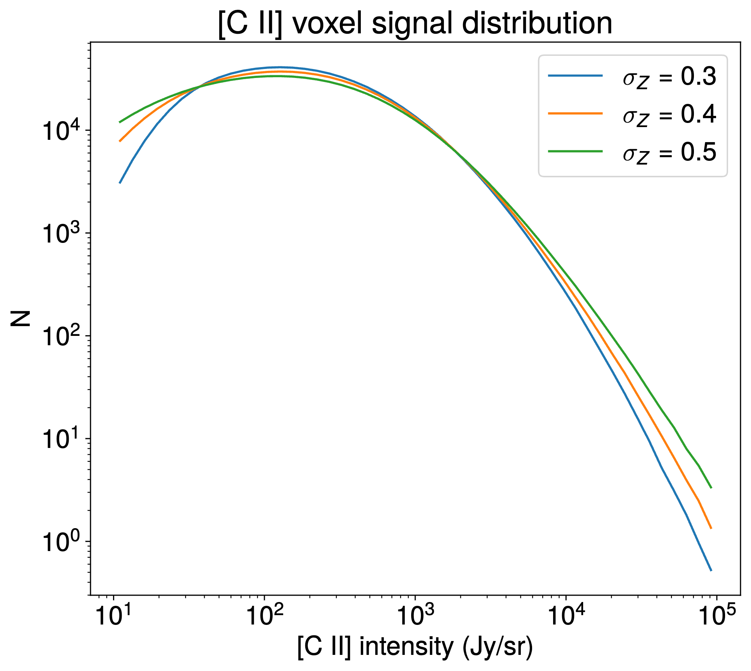
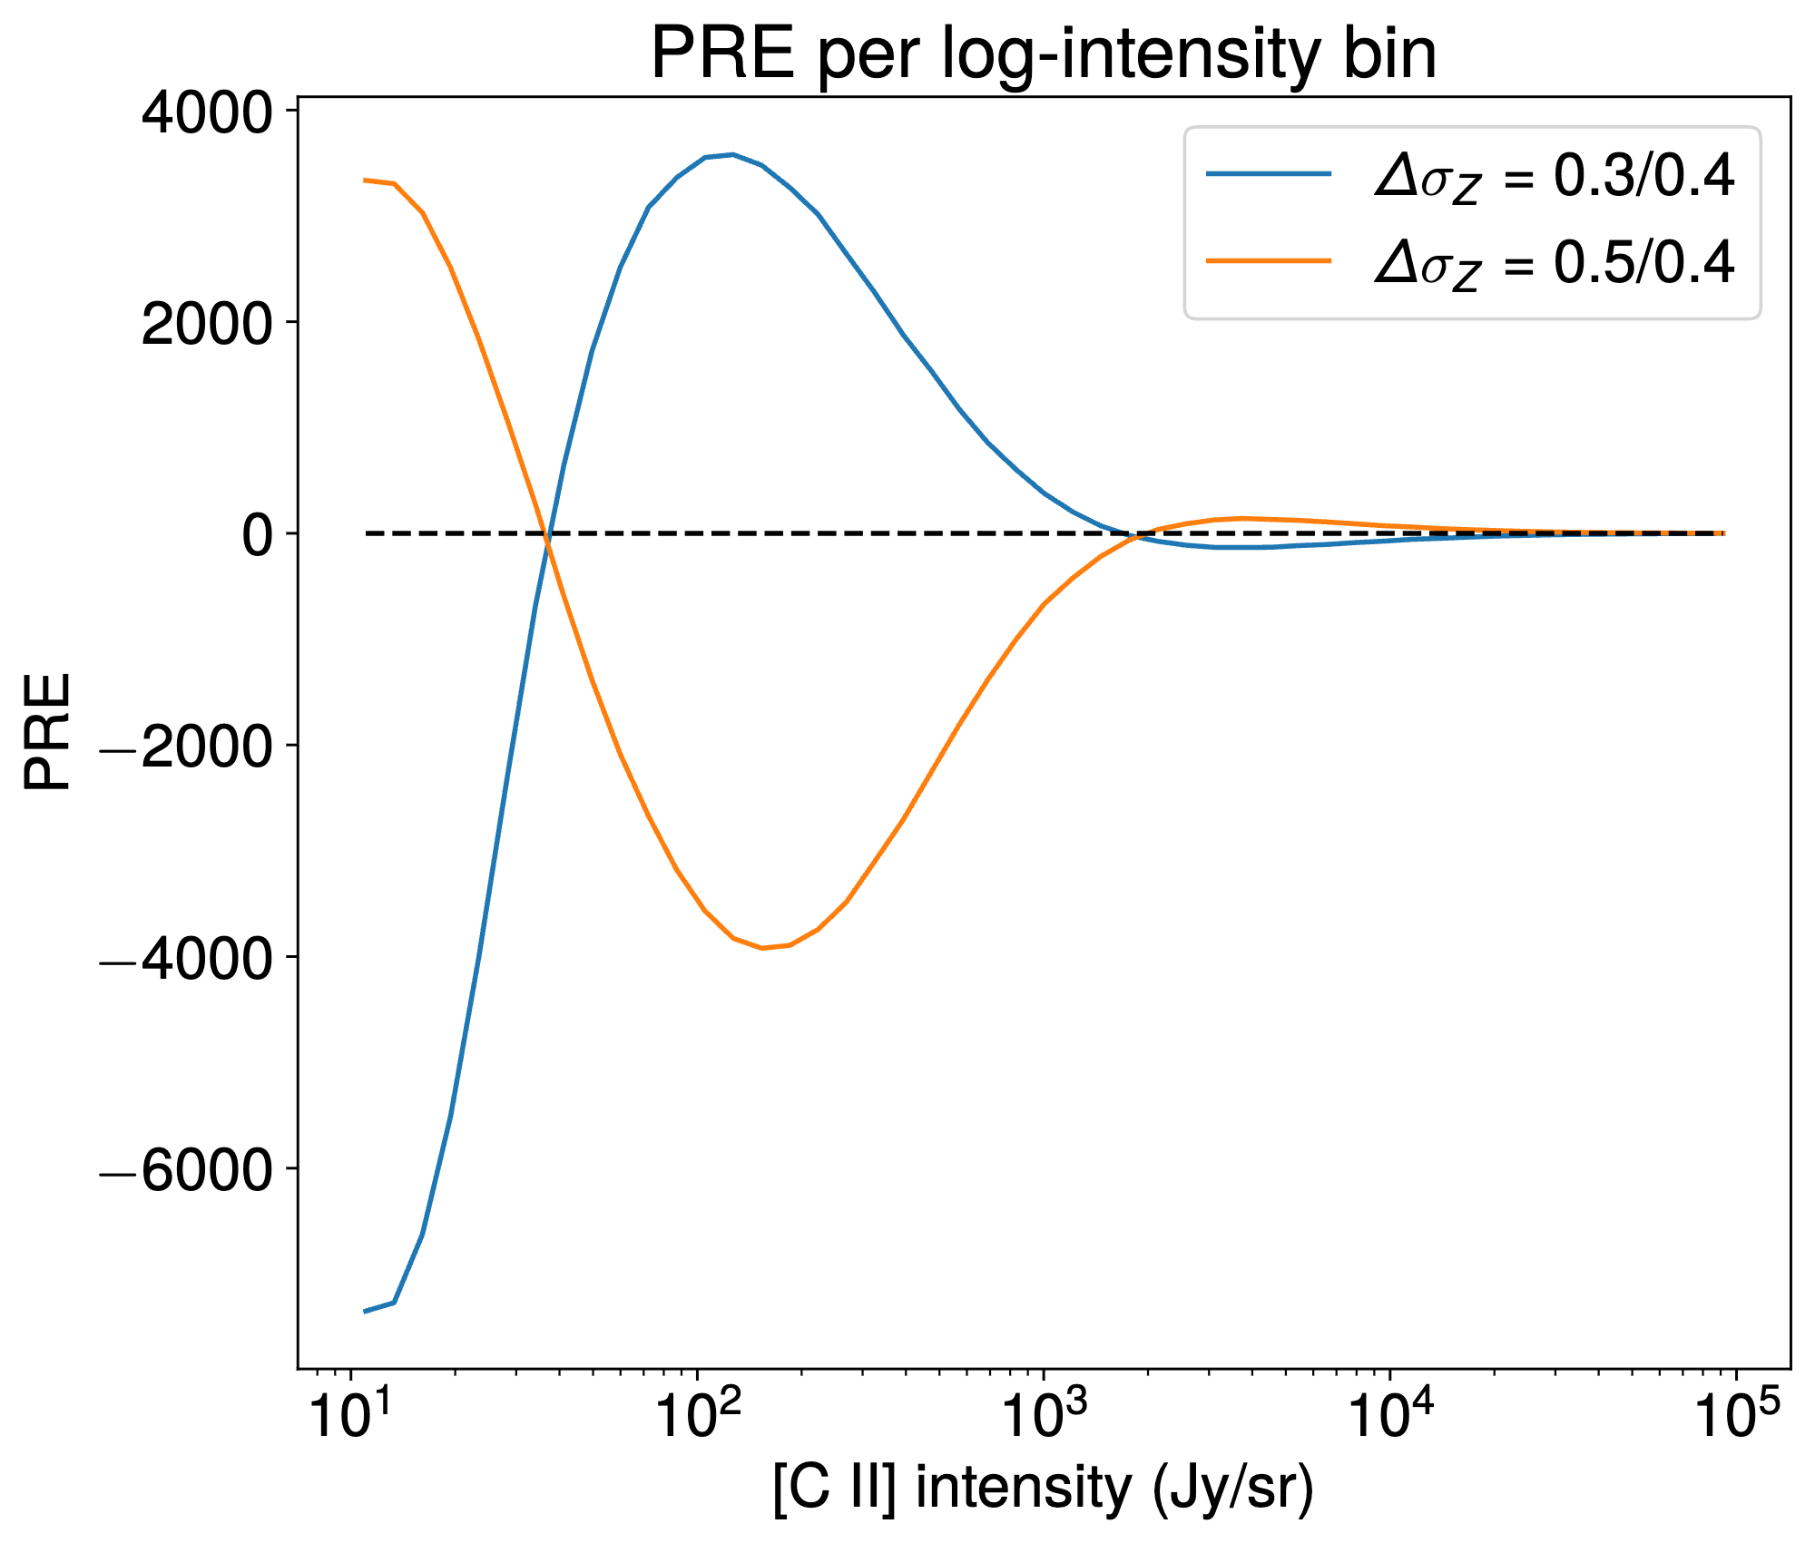
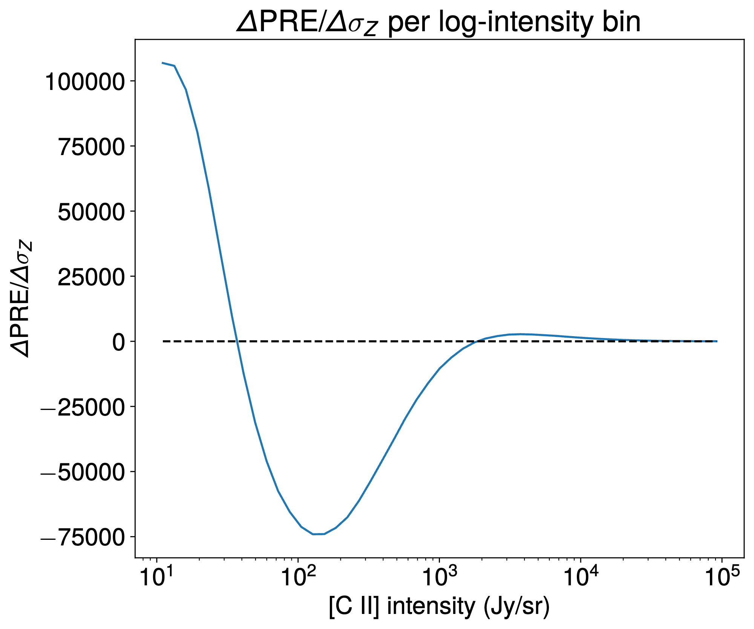
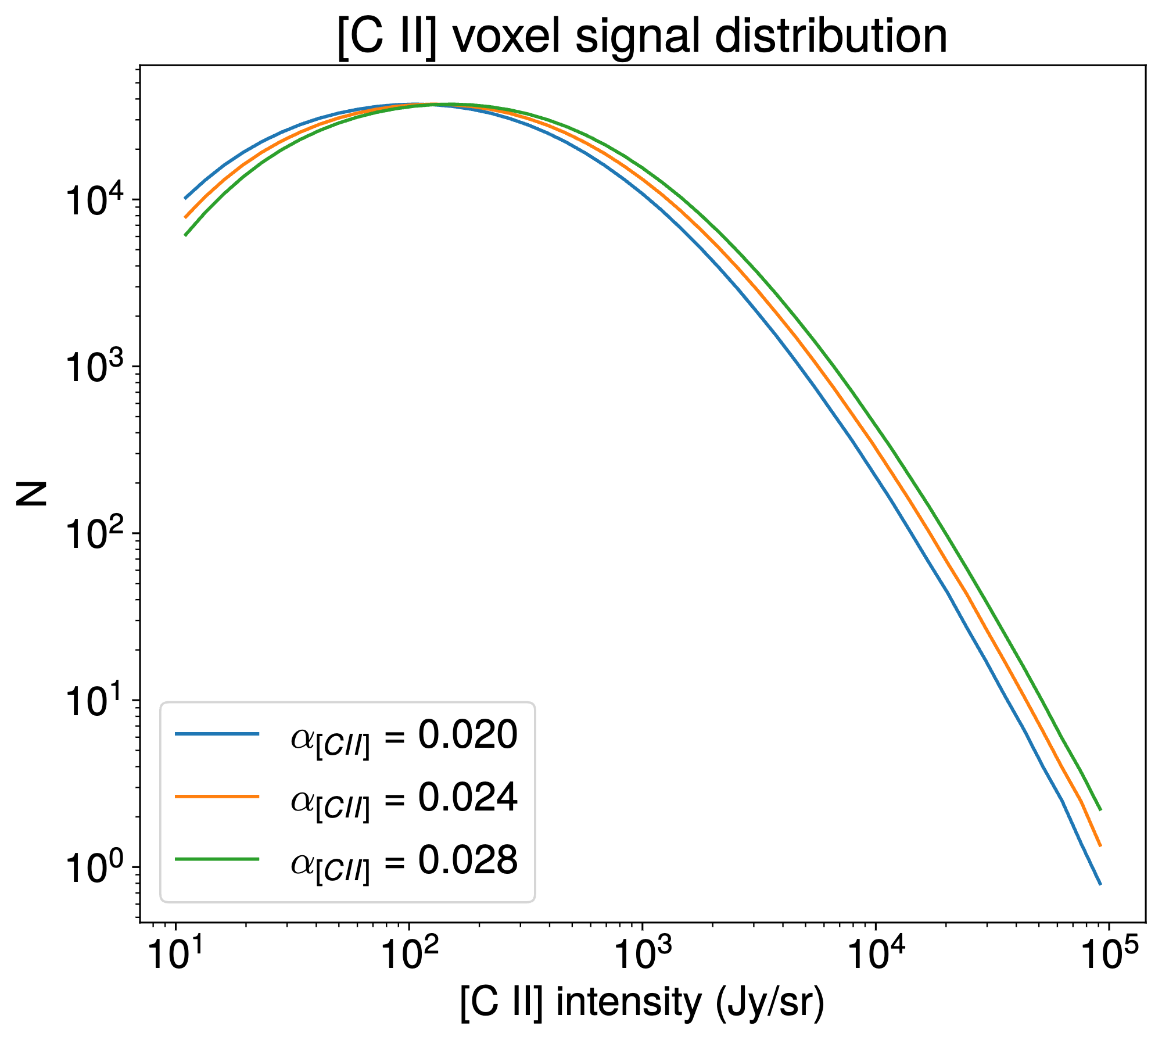
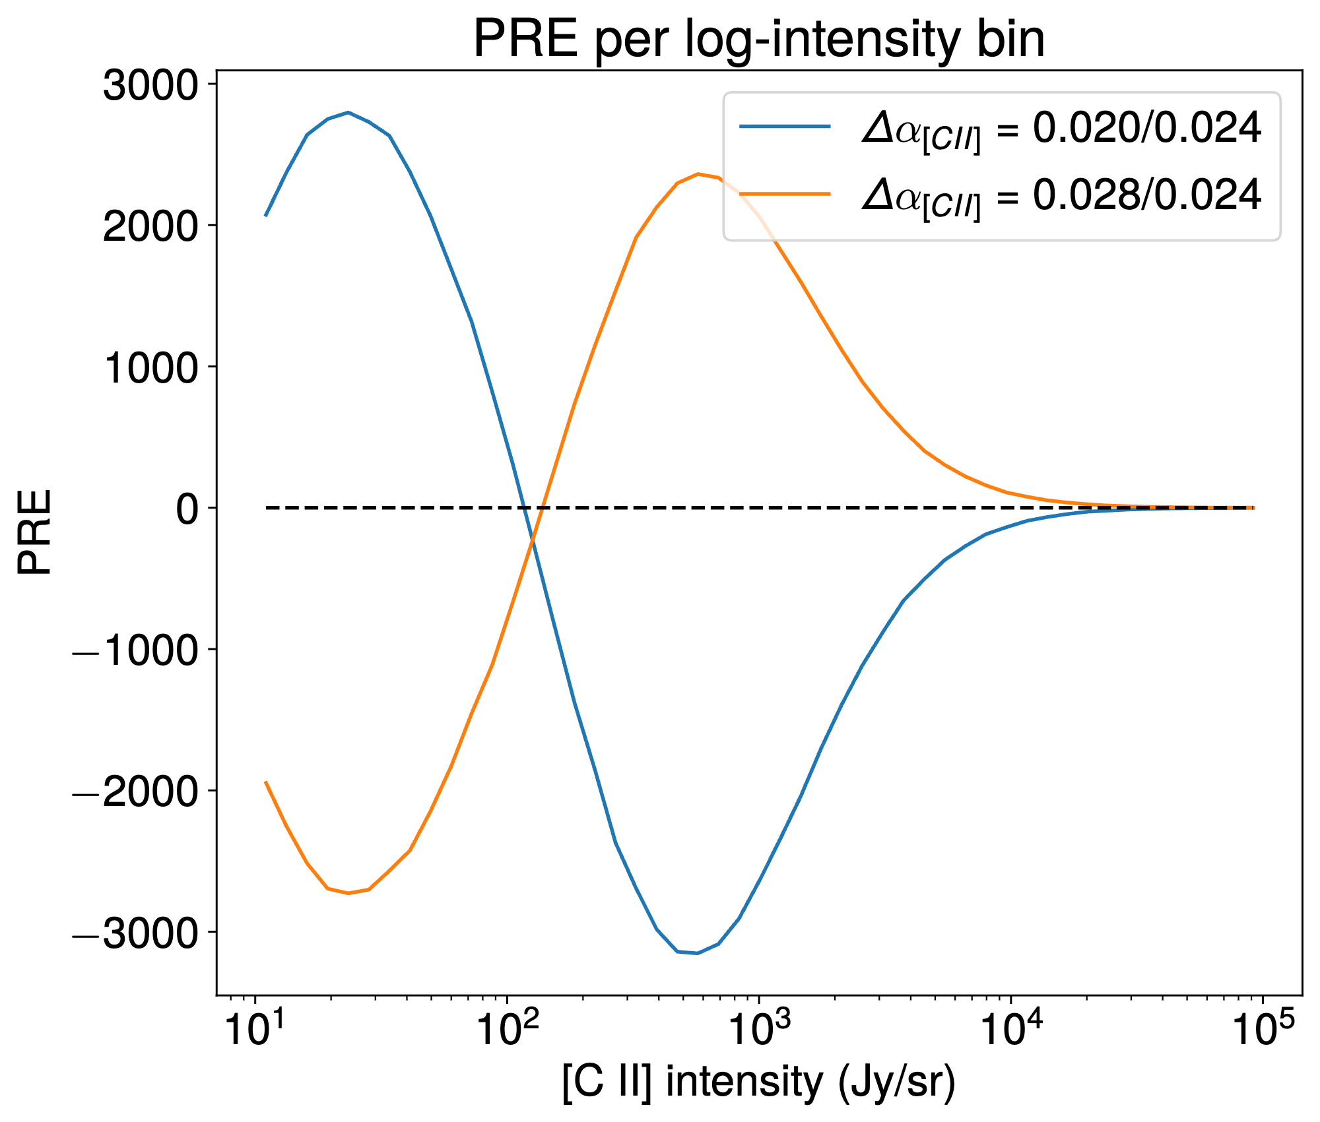
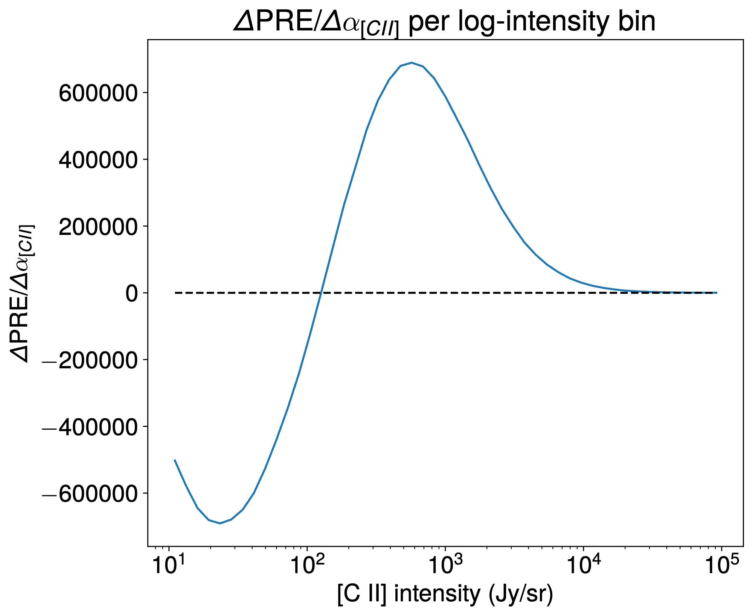



$PRE$ Applied on [C II] Maps
From distribution of intensities…
… to the PRE signature
$$σ_{Z}$$
$$α_{[CII]}$$
16

Slide 17
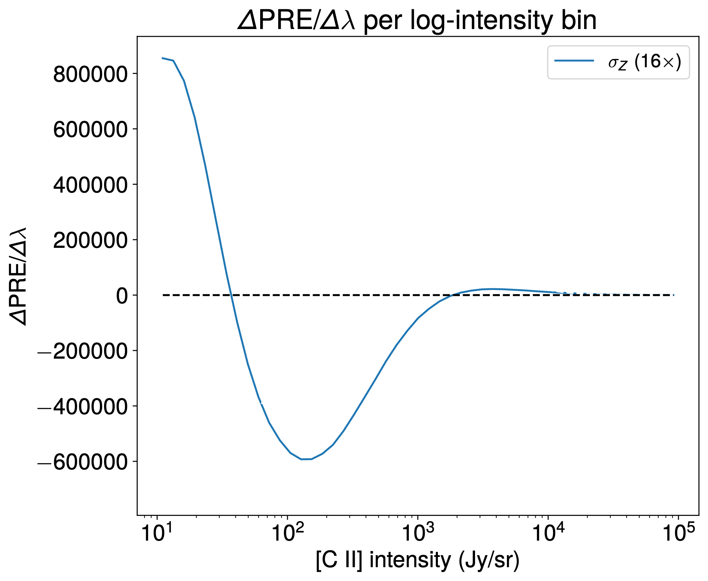
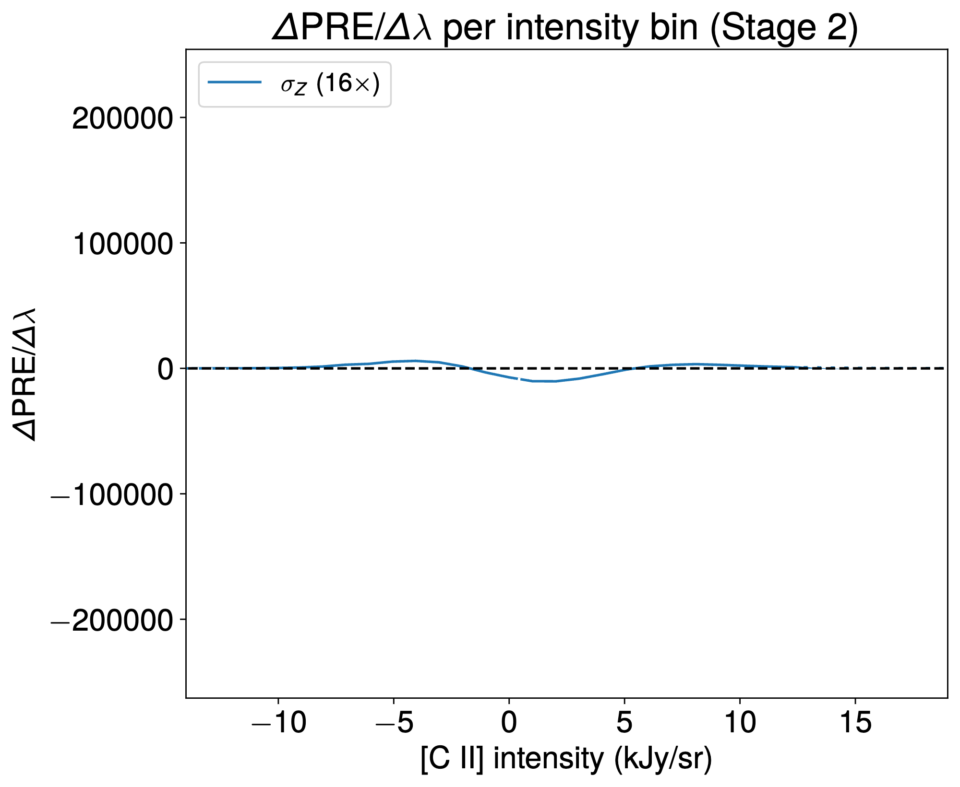
Relative Entropy
Apply on various model’s parameters
17
Notes:
- explain relative entropy, from histograms to final plots

Slide 18
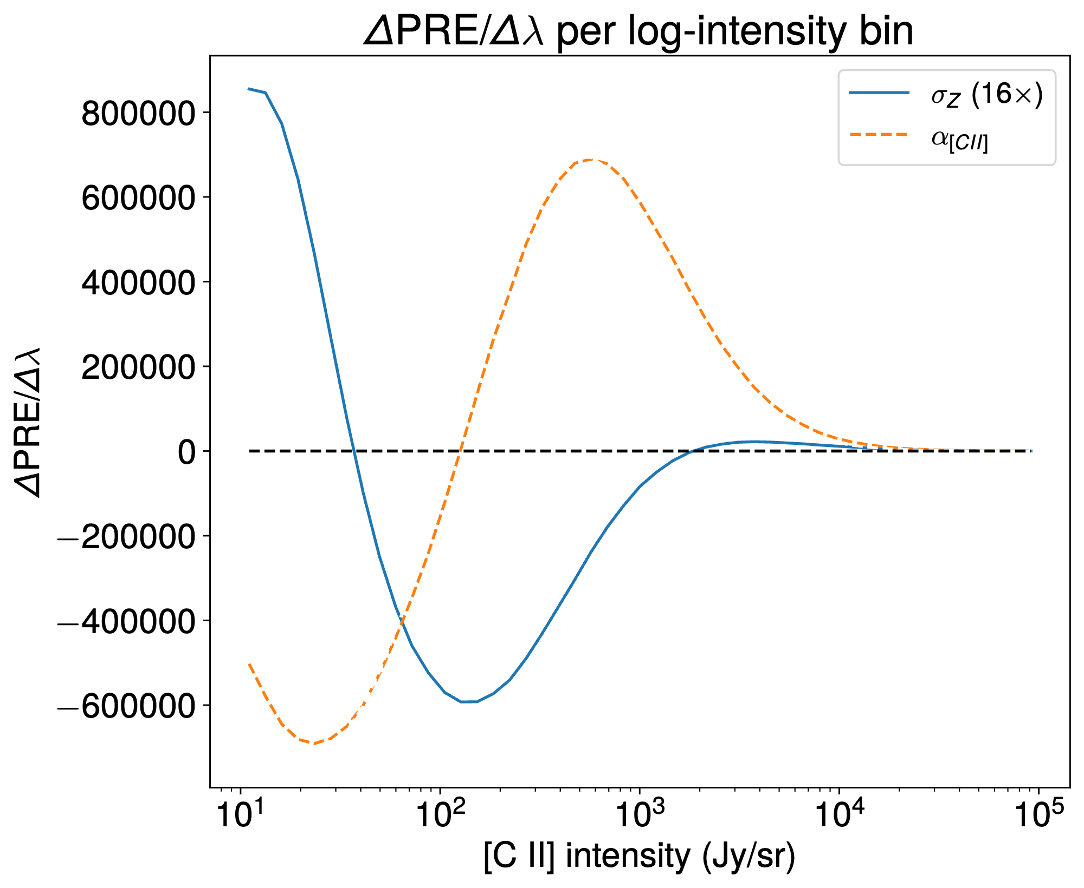
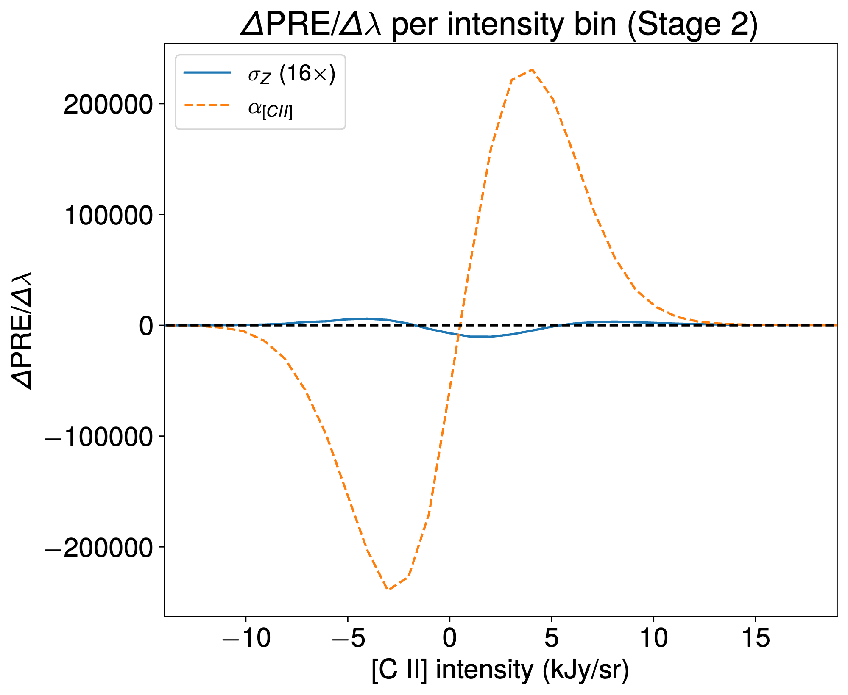
Relative Entropy
Apply on various model’s parameters
18
Notes:
- explain relative entropy, from histograms to final plots

Slide 19
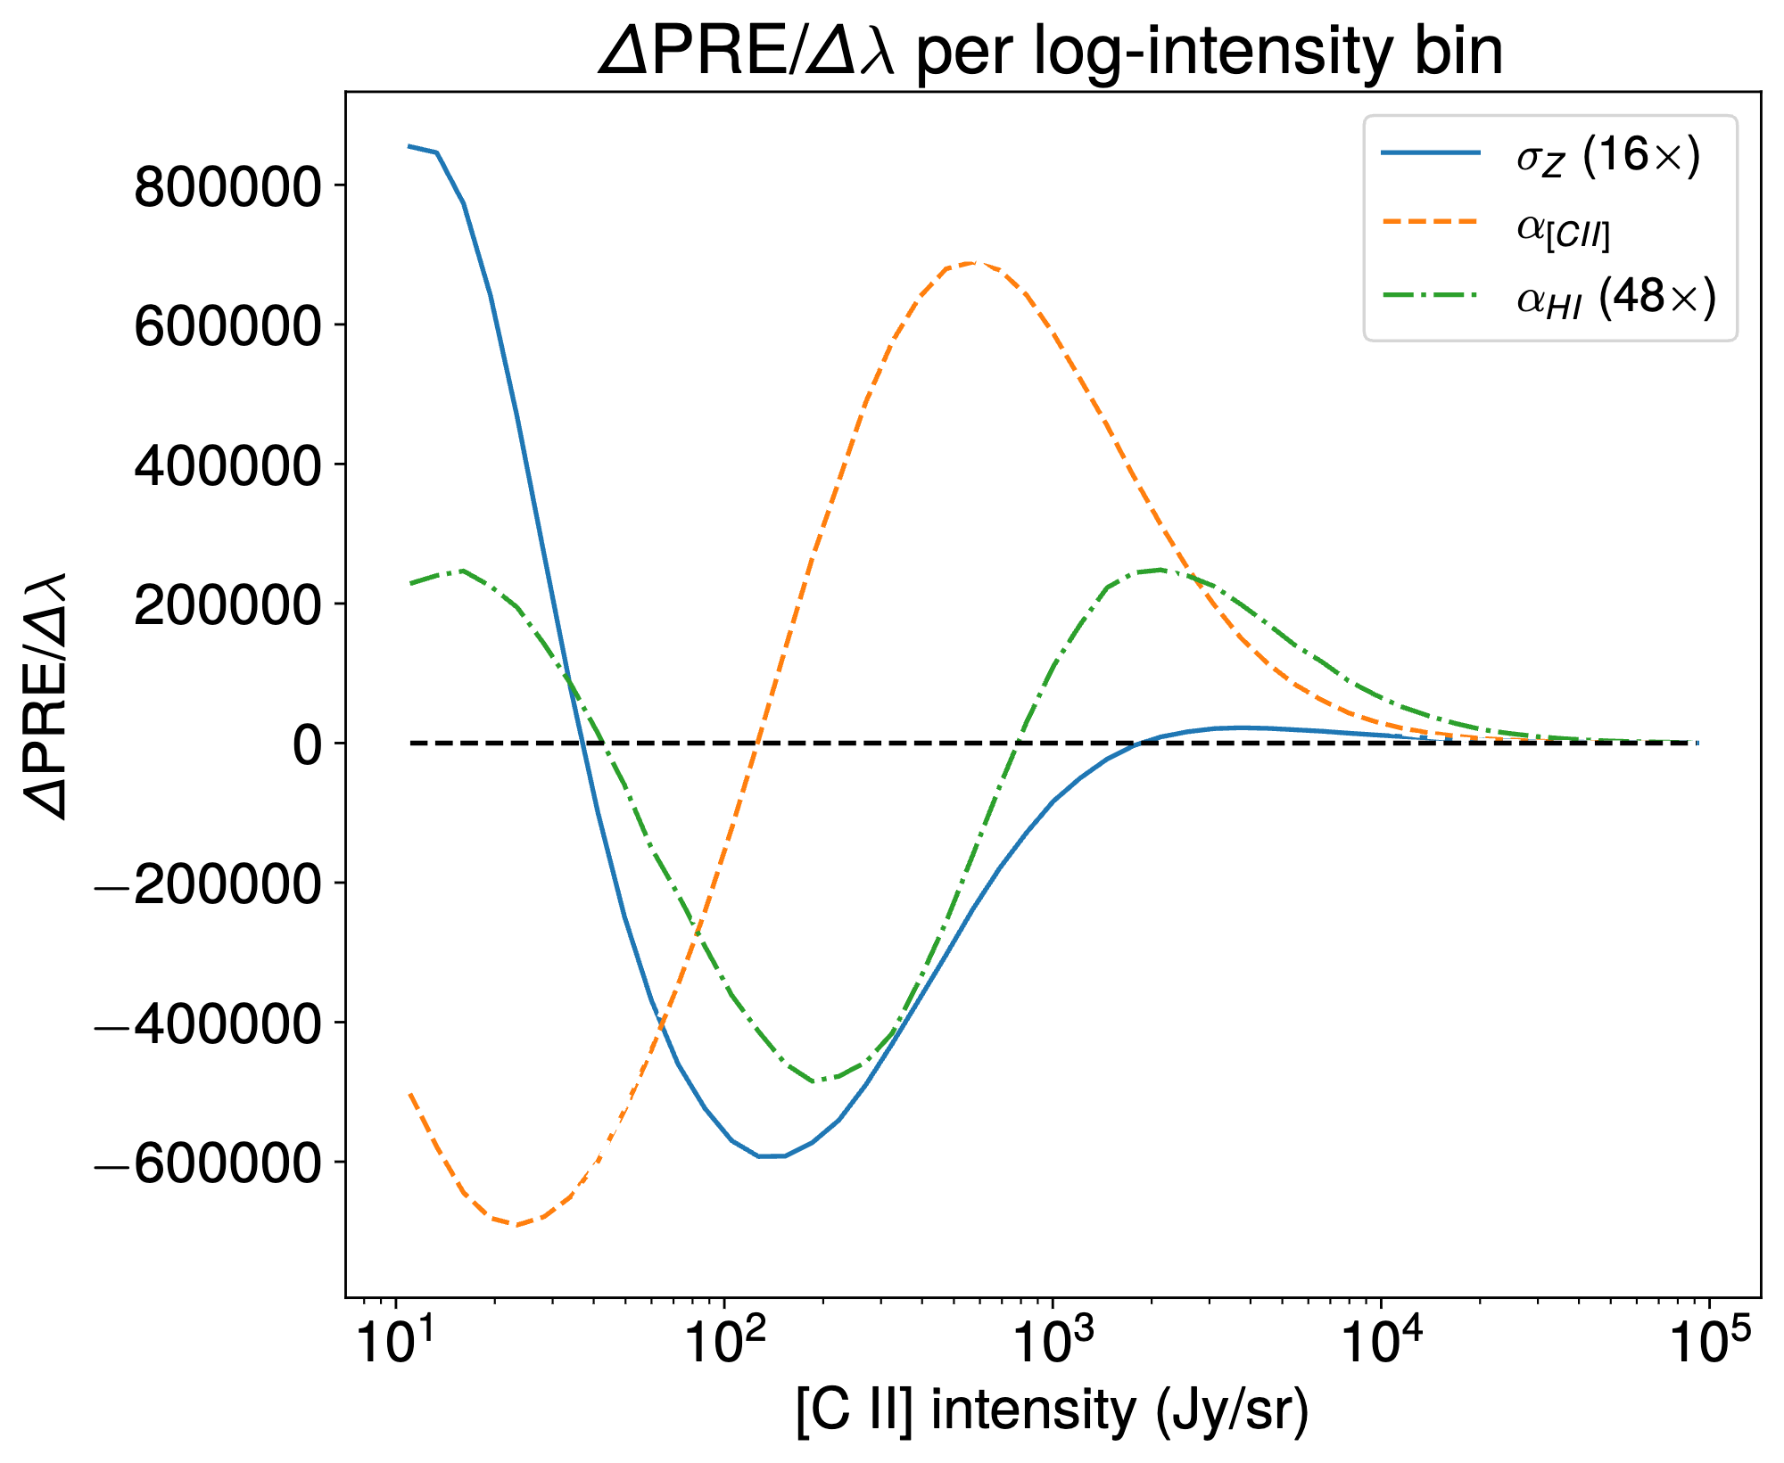
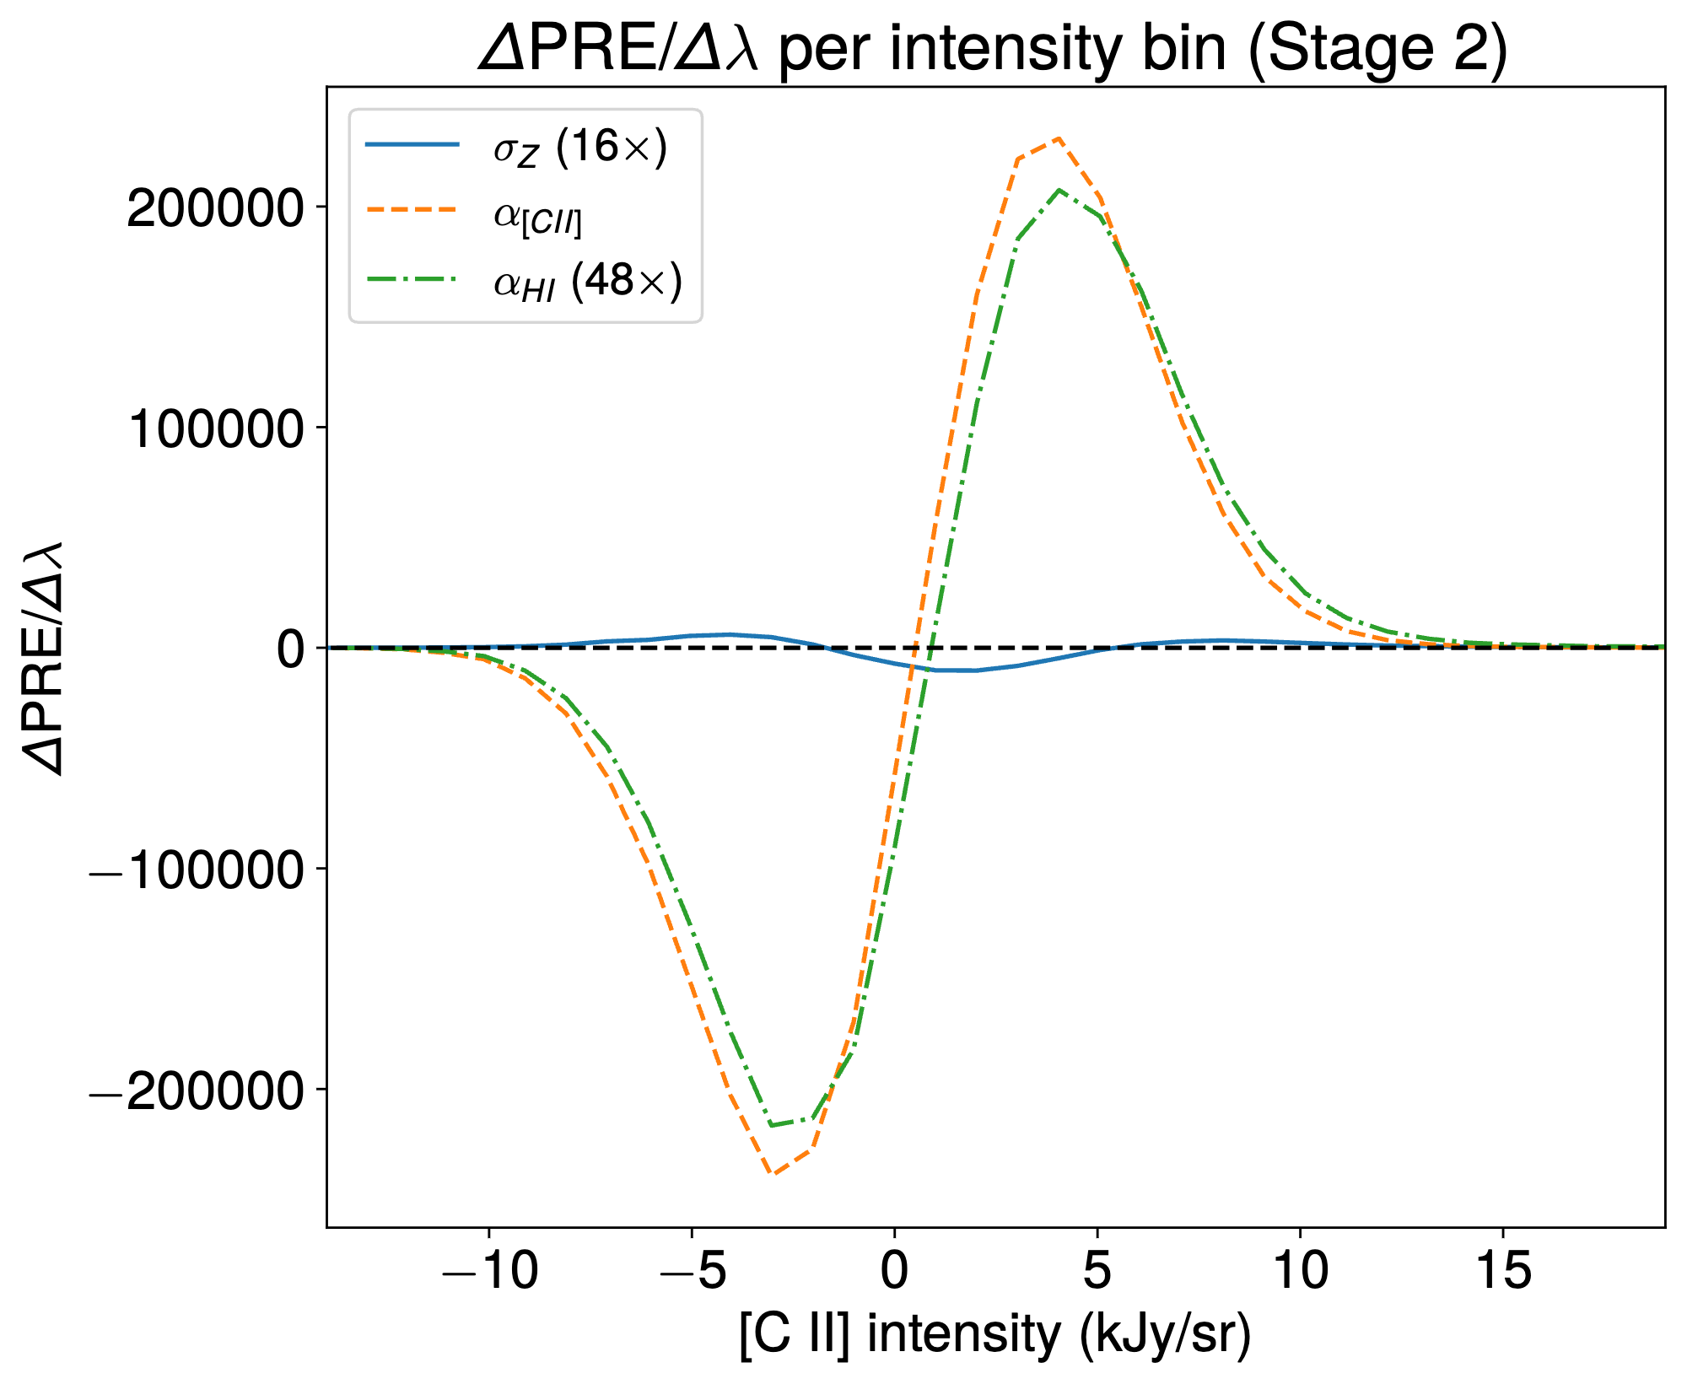
Relative Entropy
Apply on various model’s parameters
19
Notes:
- explain relative entropy, from histograms to final plots

Slide 20
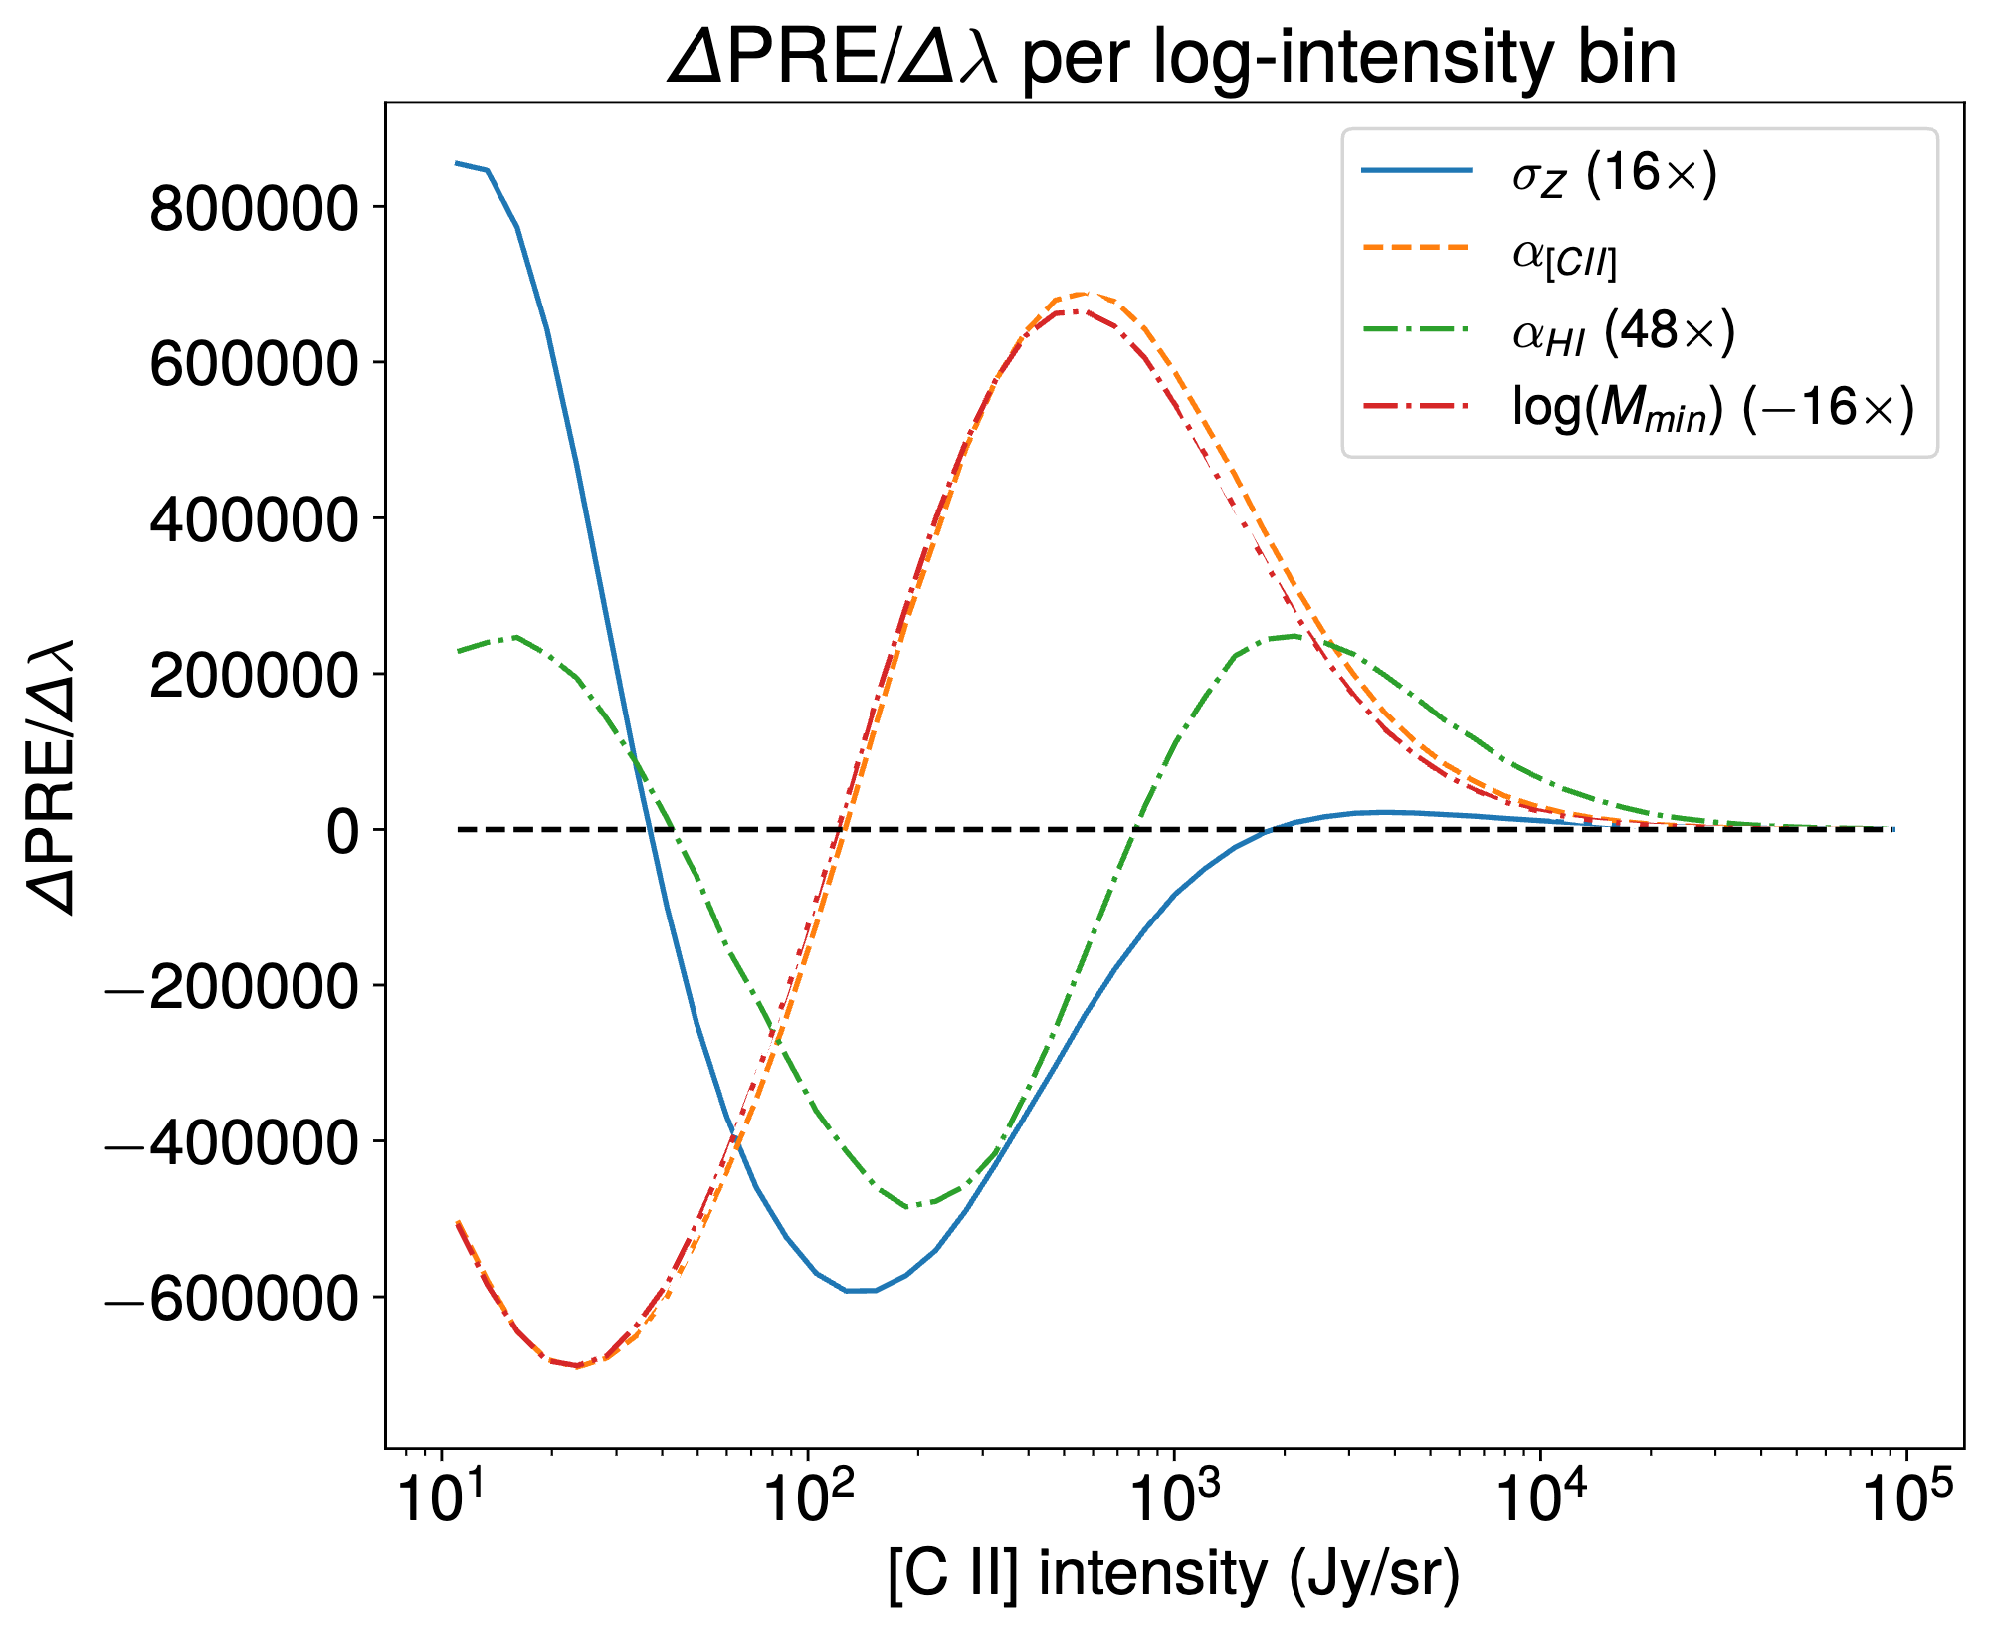
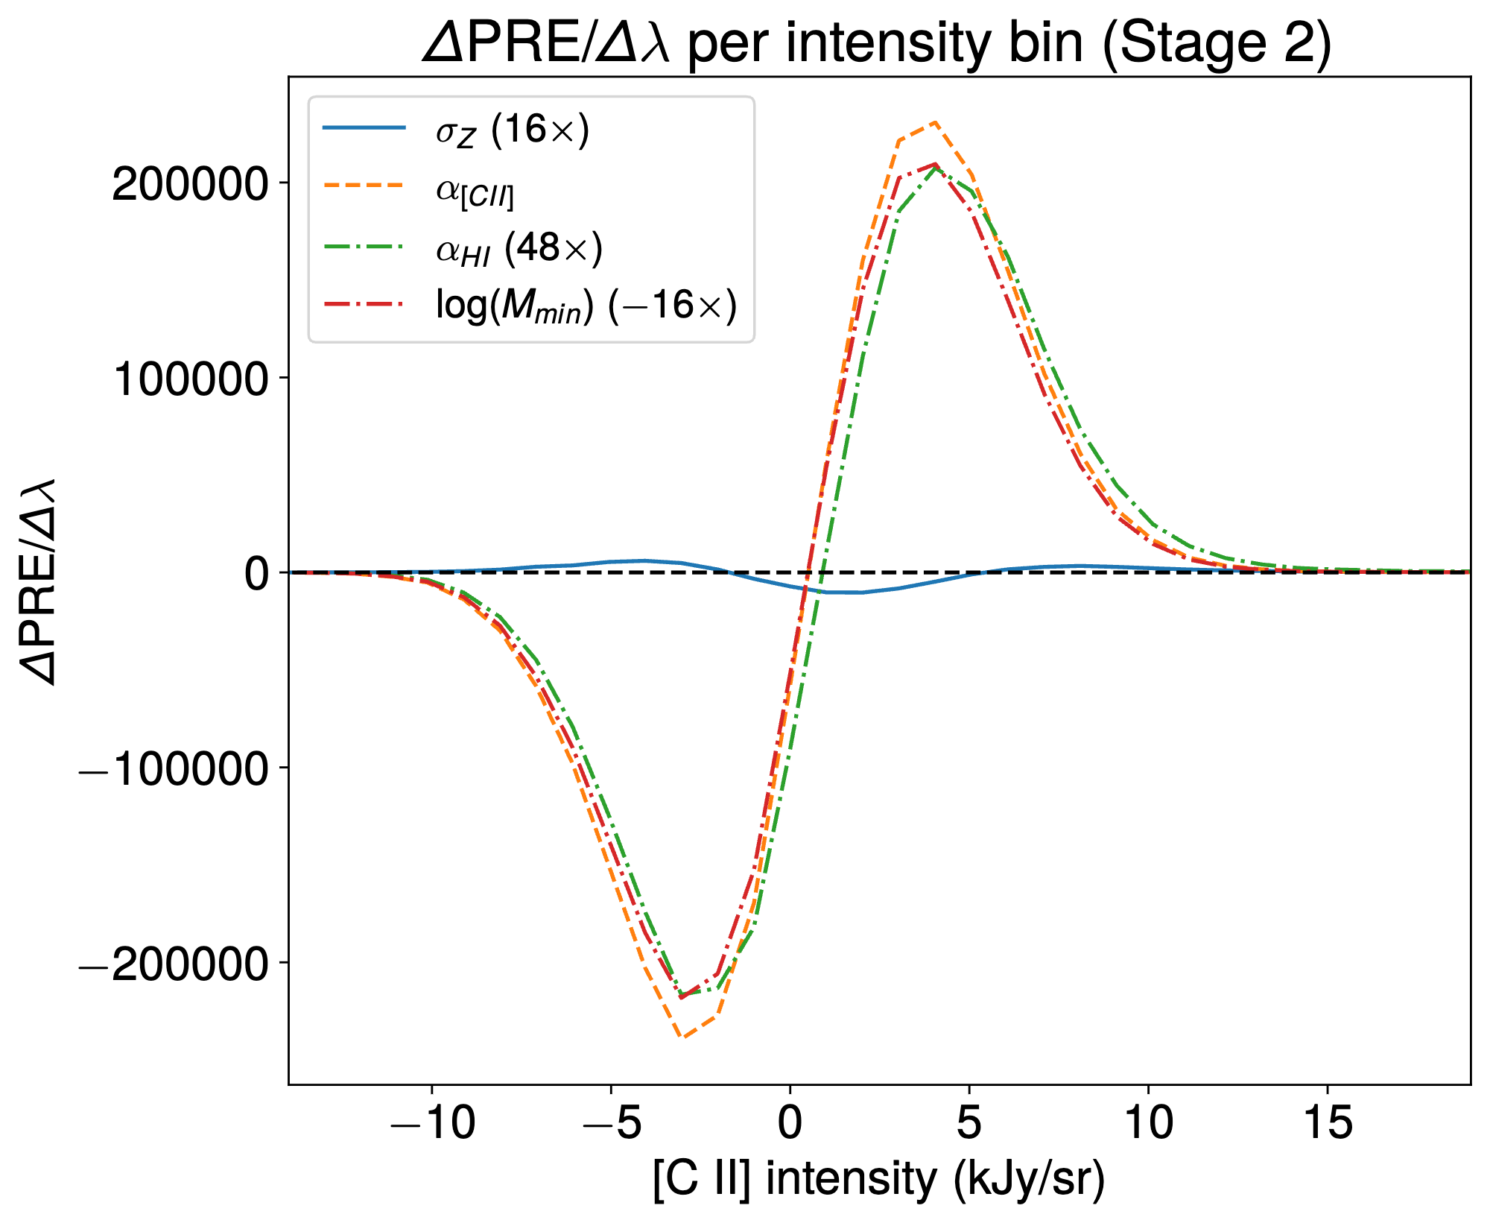
Relative Entropy
Apply on various model’s parameters
20
Notes:
- explain relative entropy, from histograms to final plots

Slide 21
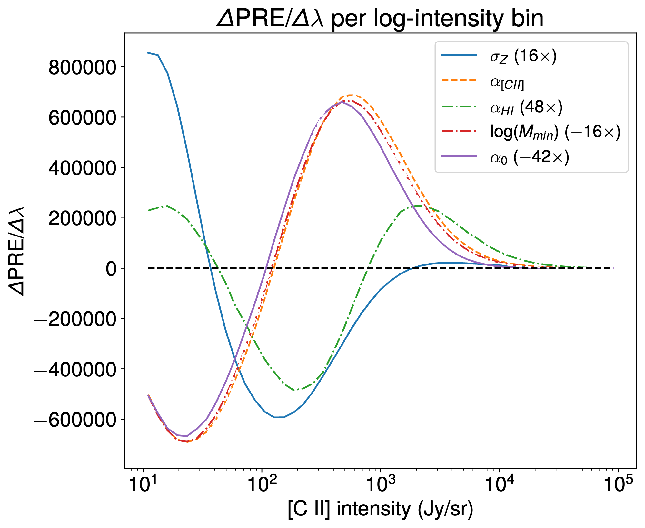
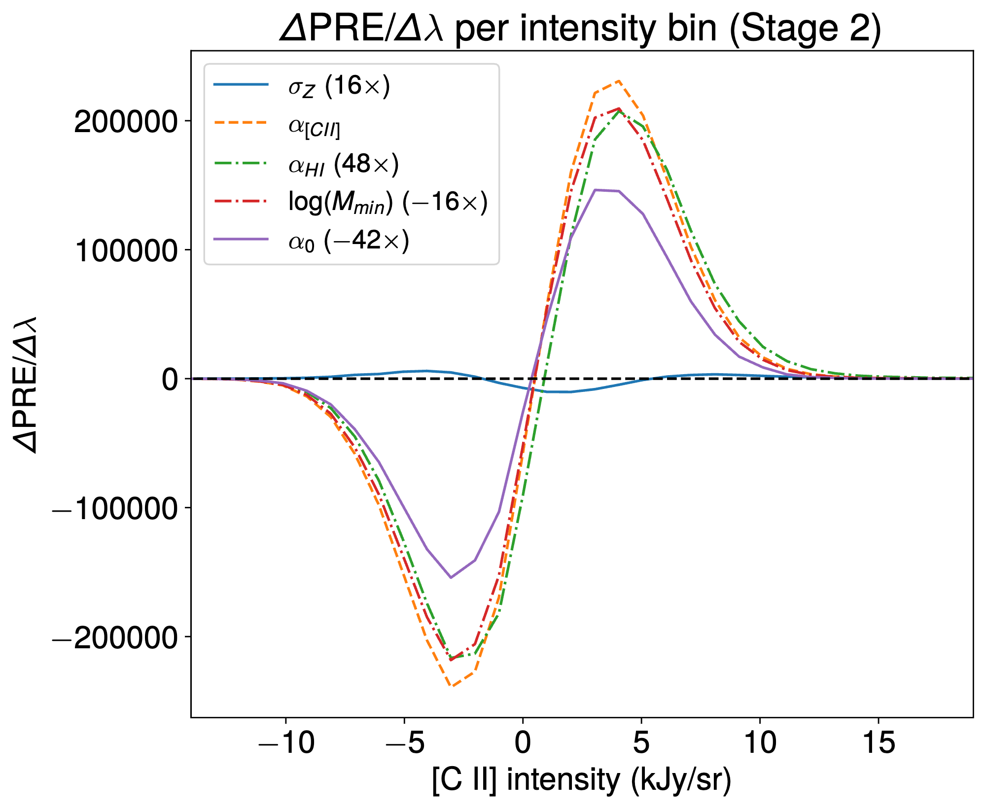
Relative Entropy
Apply on various model’s parameters
21
Notes:
- explain relative entropy, from histograms to final plots

Slide 22
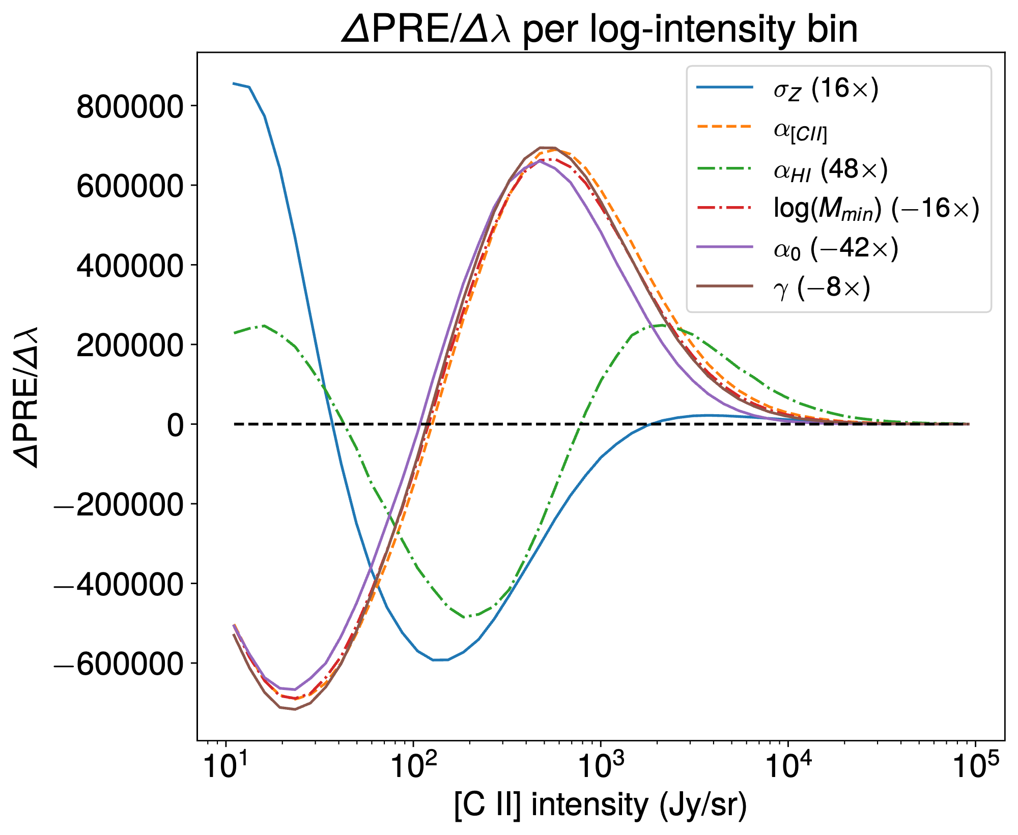
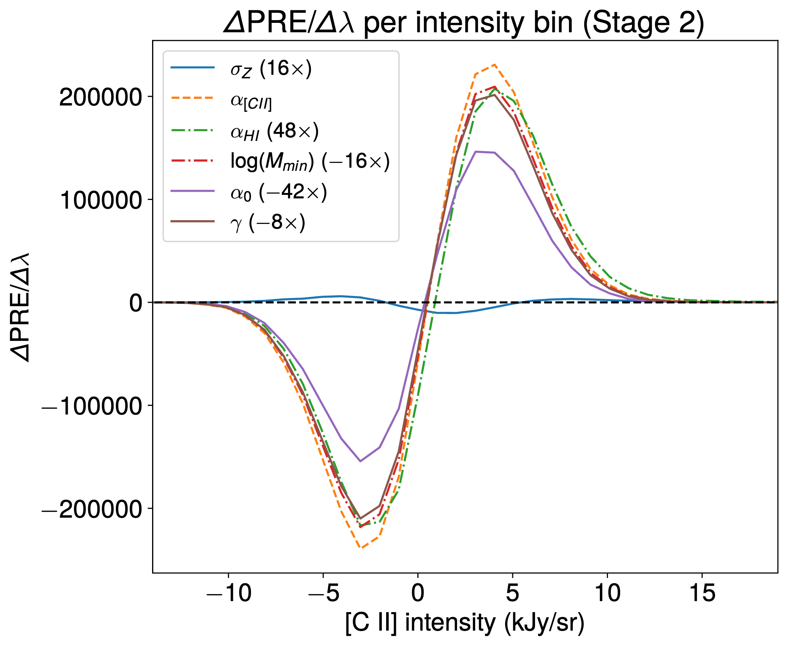
Relative Entropy
Apply on various model’s parameters
22
Notes:
- explain relative entropy, from histograms to final plots

Slide 23
Summary
LIM can probe the Universe at the Epoch of Reionisation!
We will soon detect [C II] large-scale structures!
Our model brings modelling of [C II] to the next sophistication level!
One-point statistics can extract non-Gaussian information from signal!
Degeneracy in the model’s parameters encourages further development, whether that be in new statistical methods or cross-correlations
There’s perspective to discriminate between astrophysical and cosmological non-Gaussian signatures
Paper reference: arXiv:2309.15733 (submitted to MNRAS)
https://arxiv.org/pdf/2309.15733.pdf
23
Notes:
leverage single line intensity mapping experiments with cross correlations of other lines

Slide 24
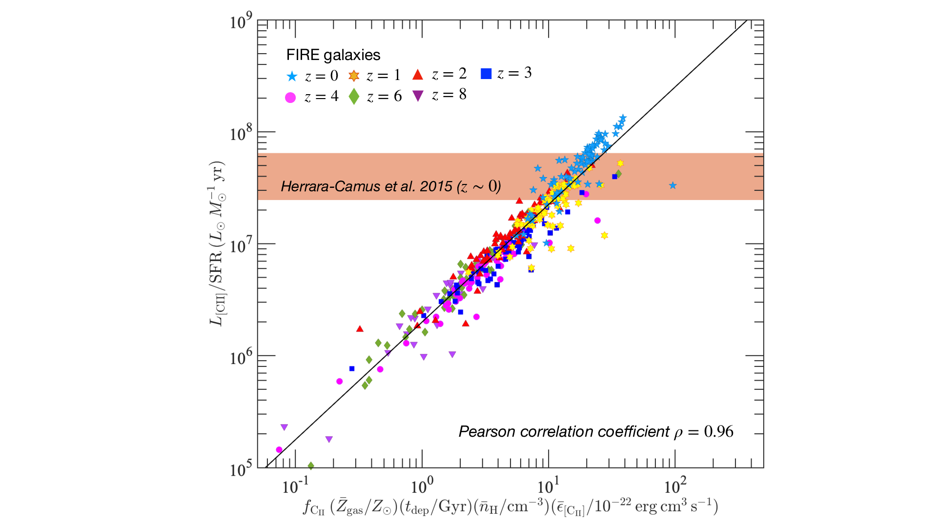
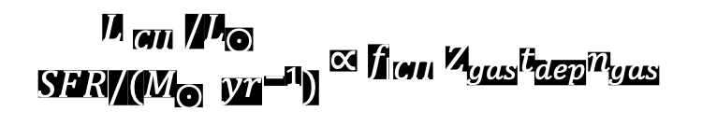
FIRE
$$\frac{L_{\left[CII\right]}/L_{⊙}}{SFR/(M_{⊙} { yr}^{−1})}∝f_{\left[CII\right]}{\overline{Z}}_{gas}t_{dep}{\overline{n}}_{gas}$$
Notes:
- explain relative entropy, from histograms to final plots

Slide 25
Results
Stacking over LBGs
Notes:
- explain stacking over LBGs

Slide 26
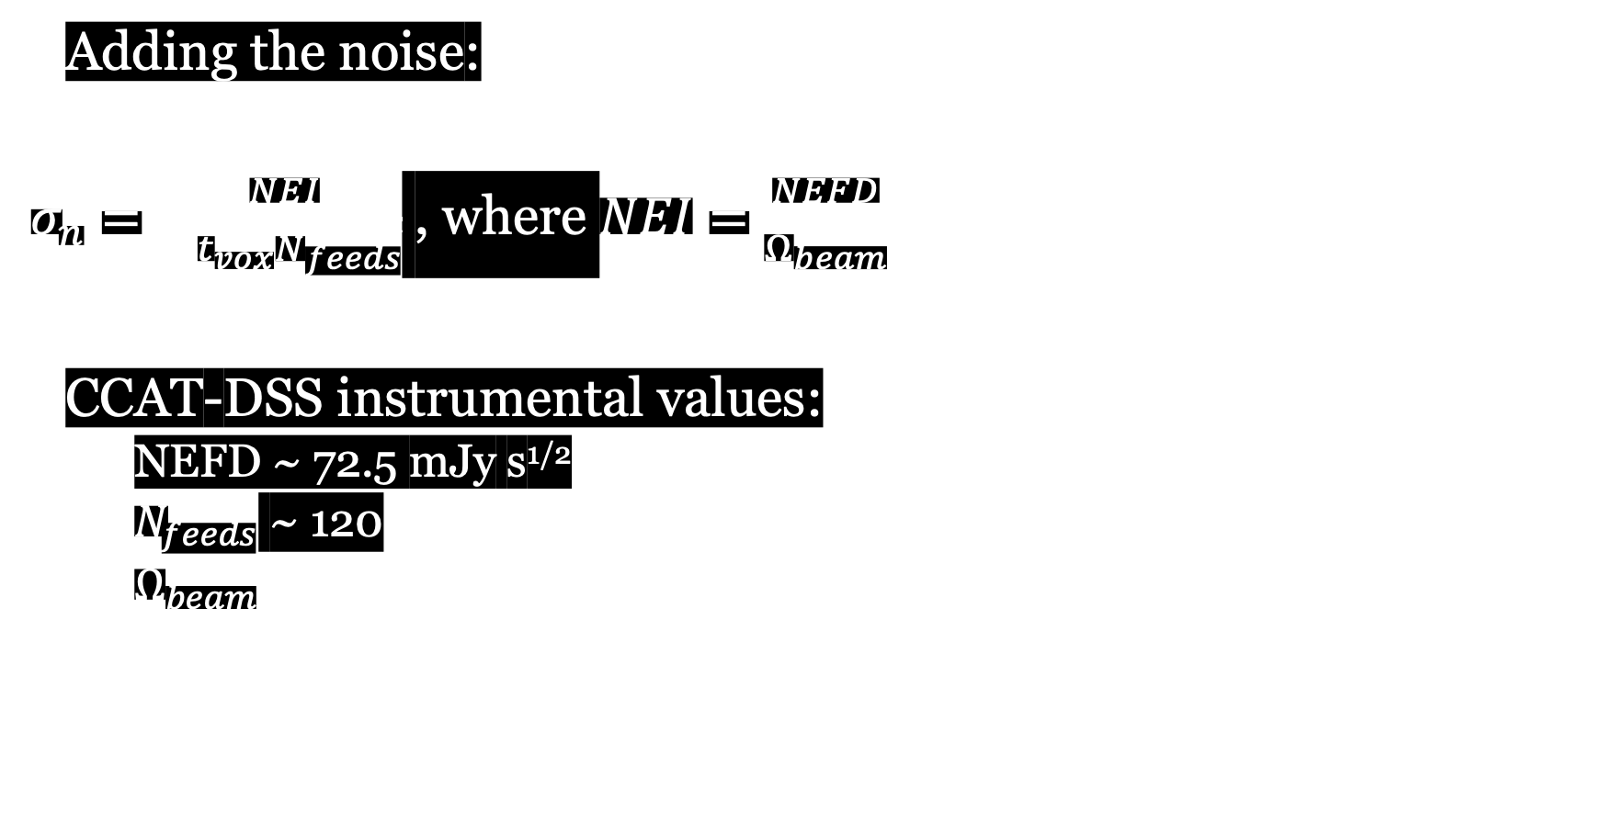
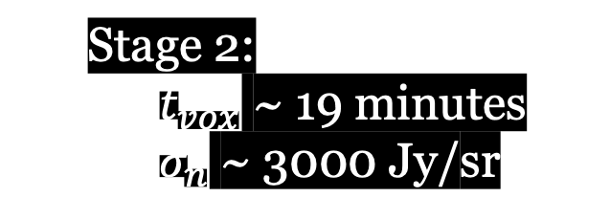
Instrumental parameters
Adding the noise:
$σ_{n}= \frac{NEI}{\sqrt{t_{vox}N_{feeds}}}$ , where $NEI=\frac{NEFD}{Ω_{beam}}$
CCAT-DSS instrumental values:
NEFD ~ 72.5 mJy s^{1/2}
$N_{feeds}$ ~ 120
$Ω_{beam}$ ~ 4 deg²
Stage 2:
$t_{vox}$ ~ 19 minutes
$σ_{n}$ ~ 3000 Jy/sr
Notes:
explain how this work builds upon results from a comprehensive analysis of the FIRE simulations
which resulted in a formula tracing CII through its metallicity, f_CII etc
and how we are using peak-patch halo lightcones processed through limlam_mocker to produce intensity maps of CII
my formula ! with each term broken down (transition from FIRE formula to my model in bonus slides?)

Slide 27
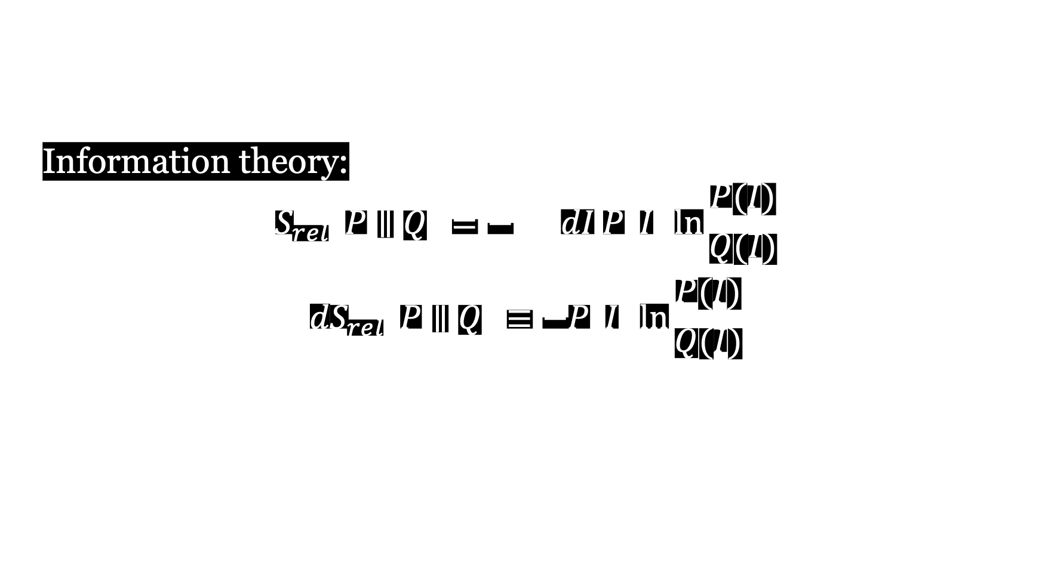
One-Point Statistics’ Formalism
Information theory:
$$S_{rel}\left(P∥Q\right)=− \int{dI P\left(I\right)\ln{\frac{P(I)}{Q(I)}}}$$
$${dS}_{rel}\left(P∥Q\right)≡−P\left(I\right)\ln{\frac{P(I)}{Q(I)}}$$
13

